Slide 1
SRA Metadata Analysis
Comprehensive Analysis of Illumina Sequencing Data
November 18, 2025

Slide 2
Dataset Overview
📊 Total SRA Runs: 2,880
👥 Unique Samples (Patients): 2,712
📈 Average Runs per Sample: 1.06
🔄 Samples with Multiple Runs: 87 (3.2%)
📋 Total Metadata Columns: 300
🧬 Phenotype Columns Analyzed: 27
🔬 Platform: Illumina Only
📊 Visualizations Generated: 45

Slide 3
Sequencing Instruments

Slide 4
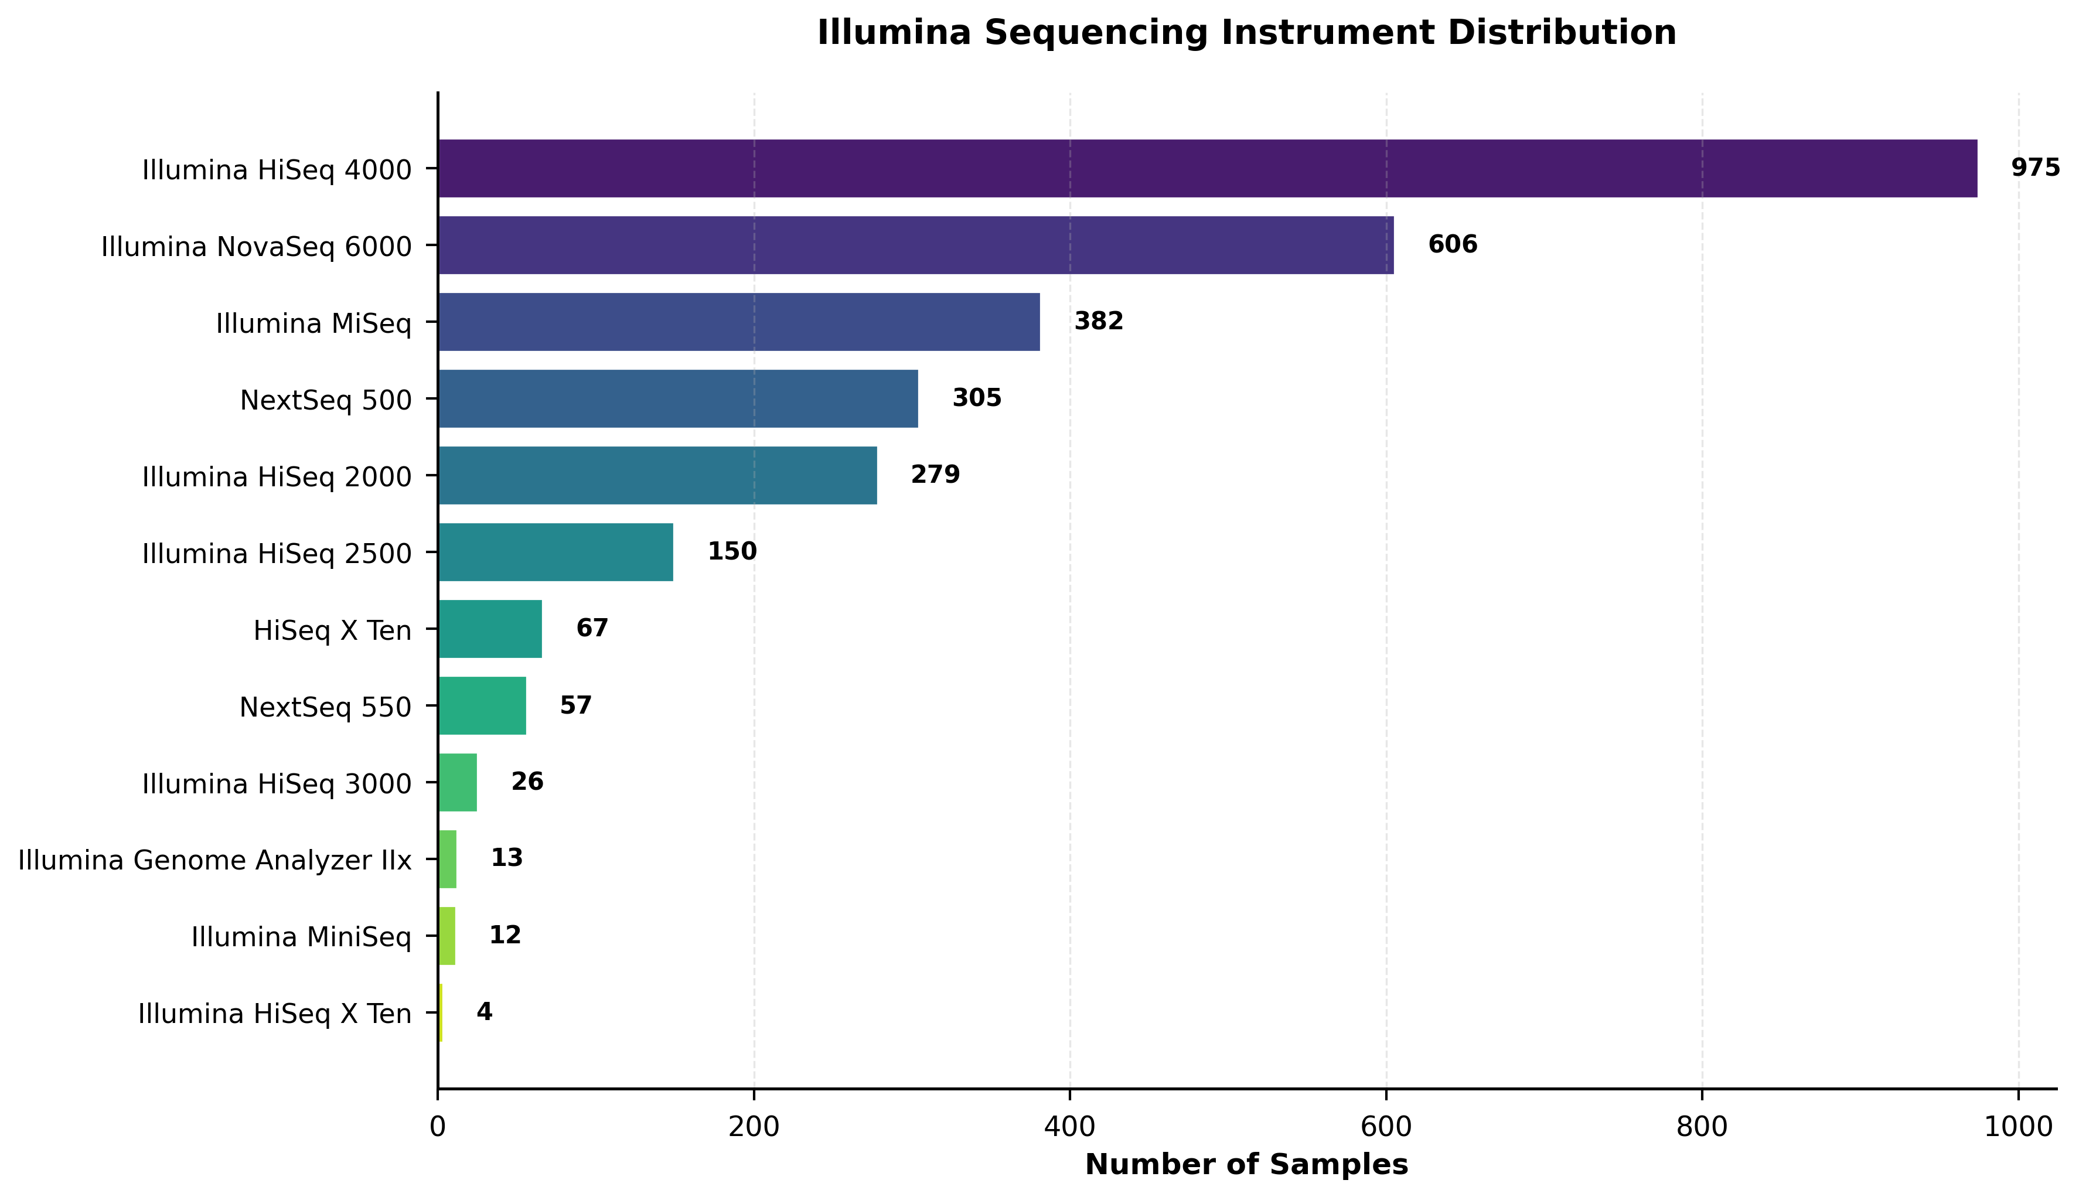
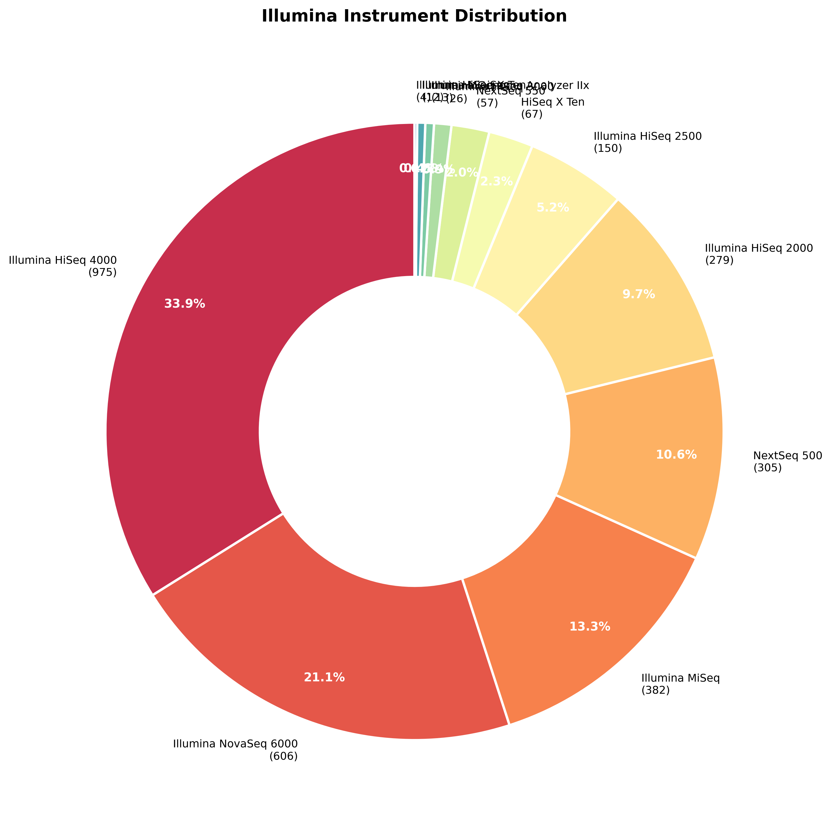
Sequencing Instruments

Slide 5
Library Preparation Strategies

Slide 6
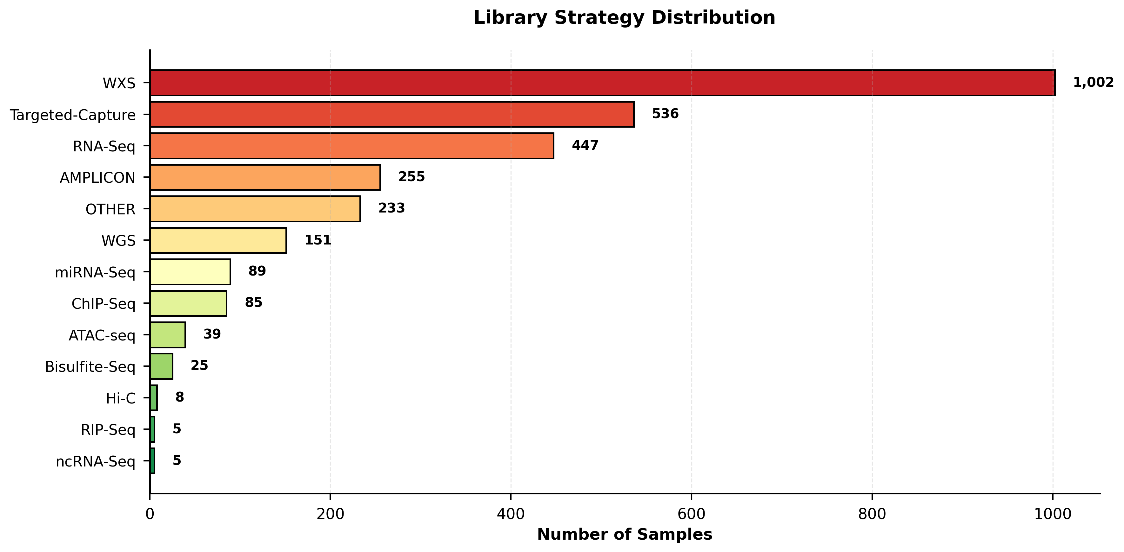
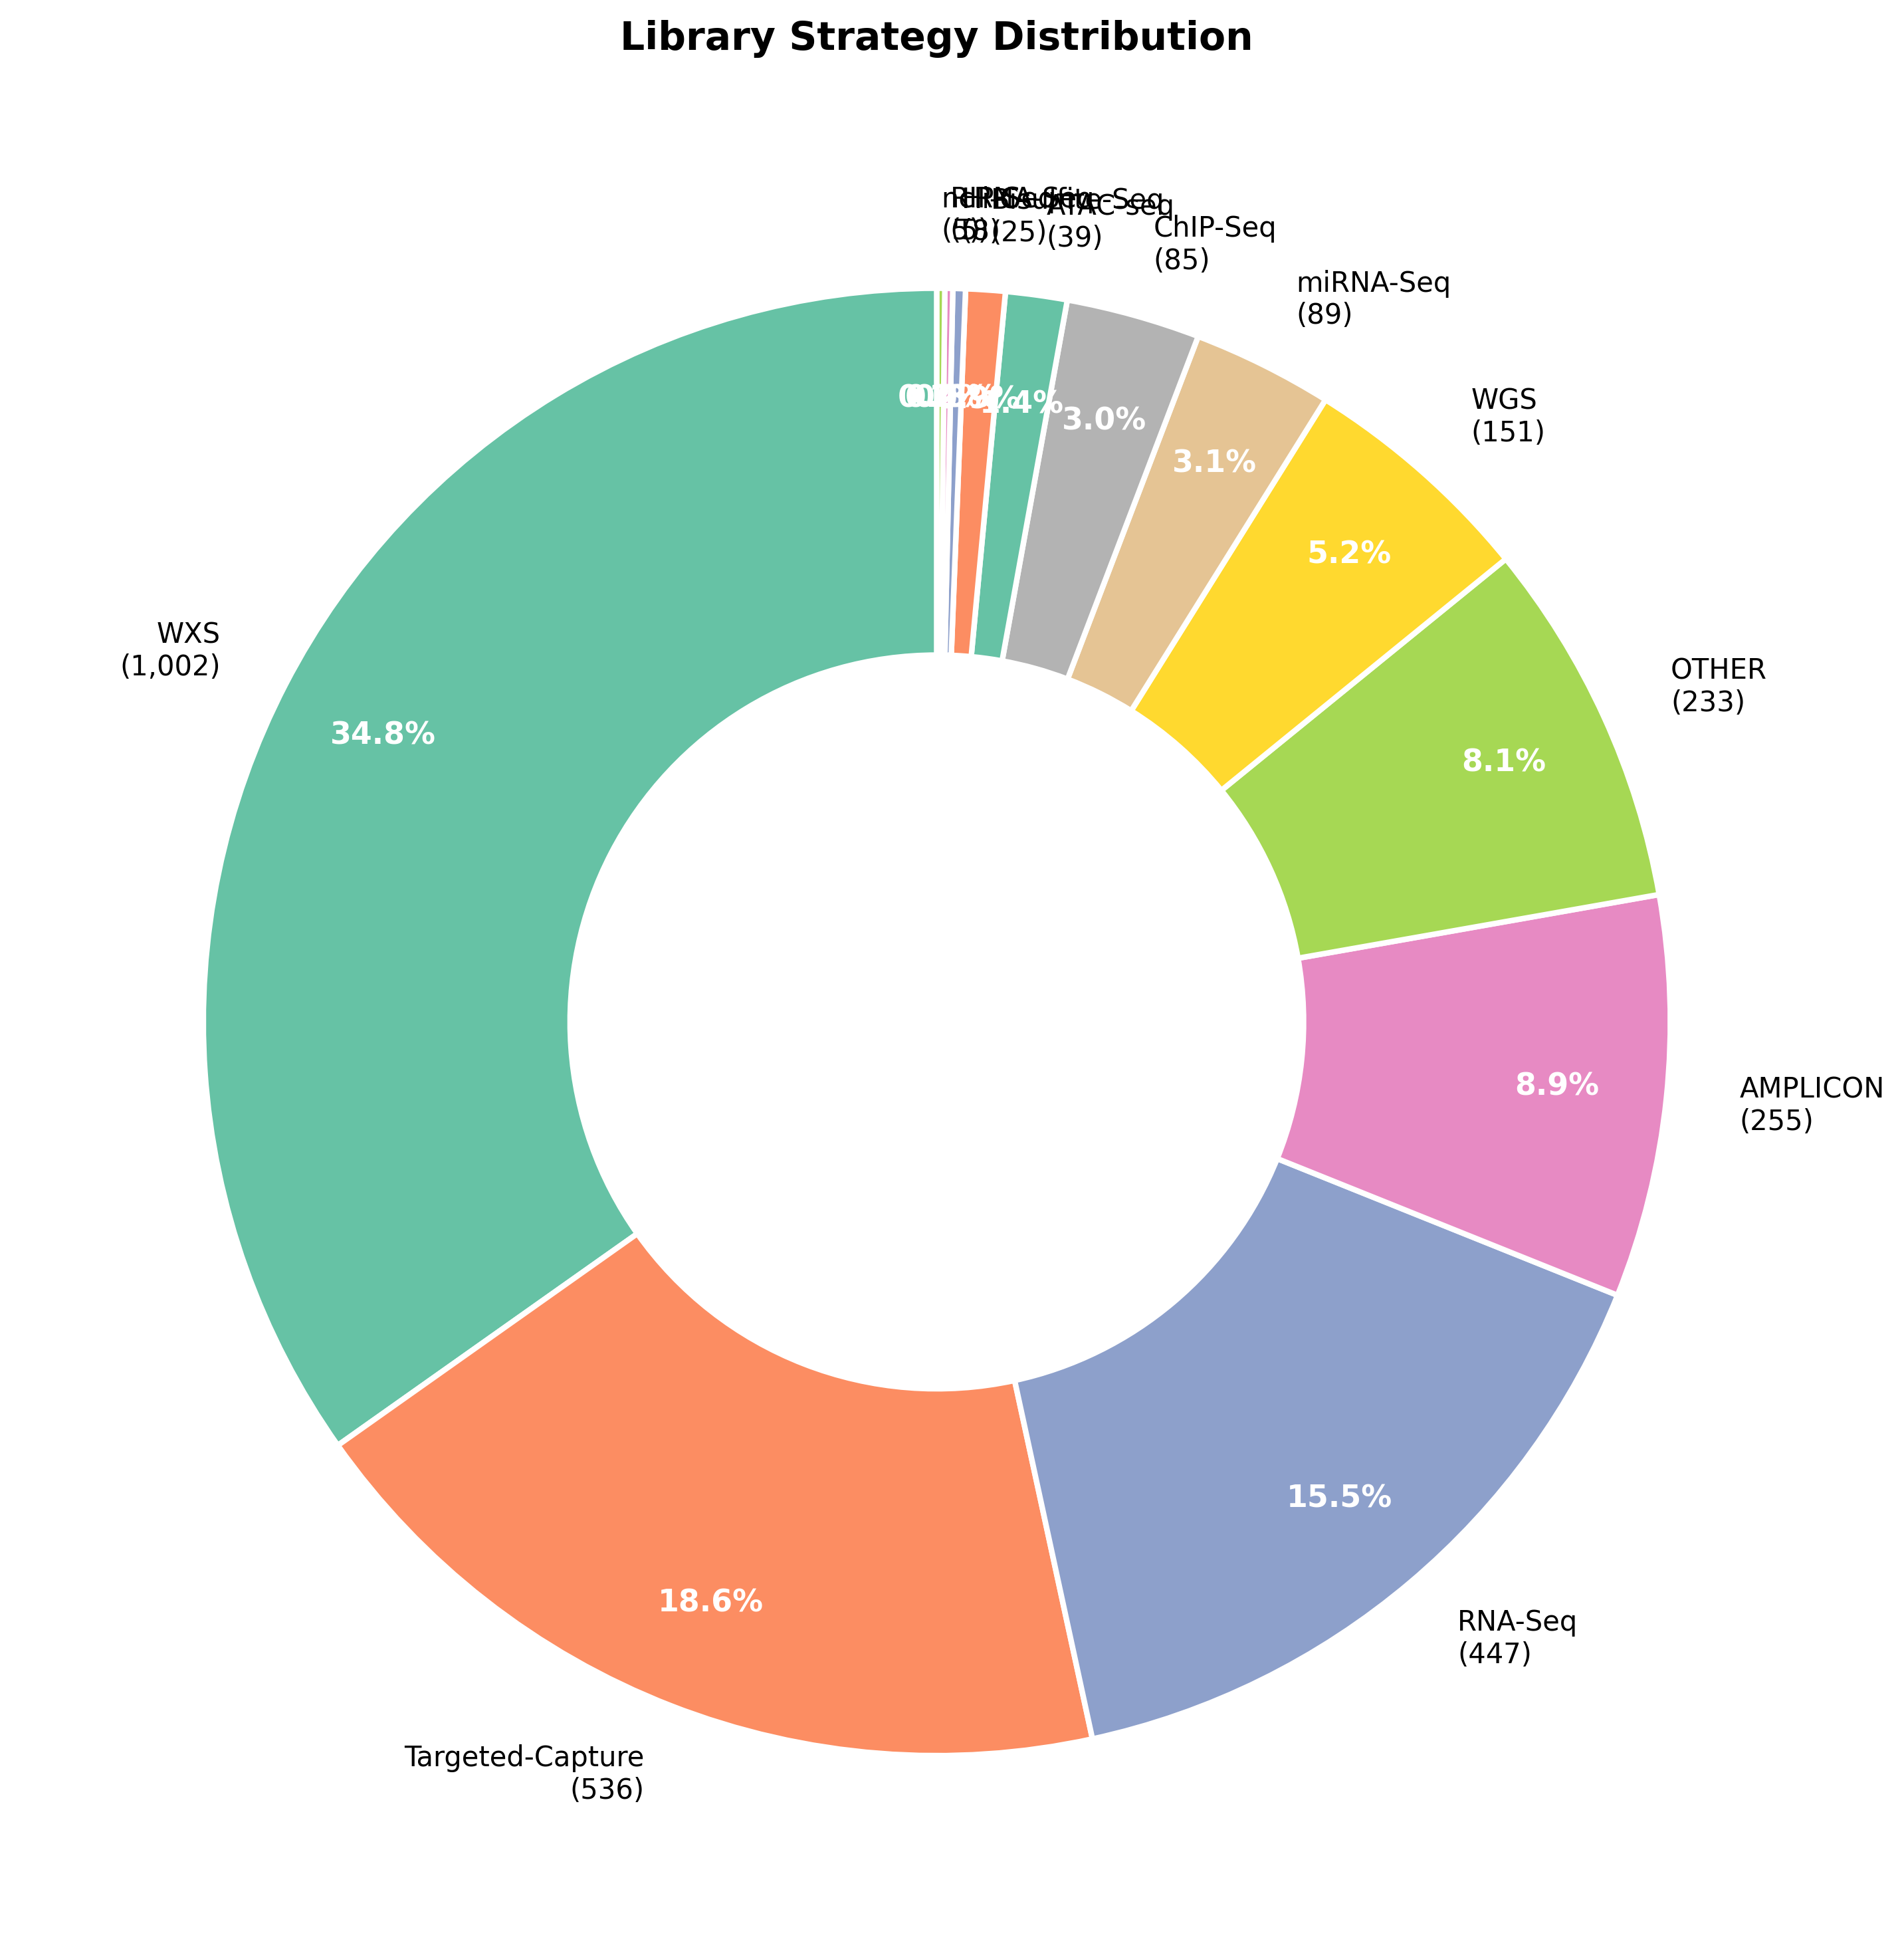
Library Preparation Strategies

Slide 7
Sequencing Depth Analysis

Slide 8
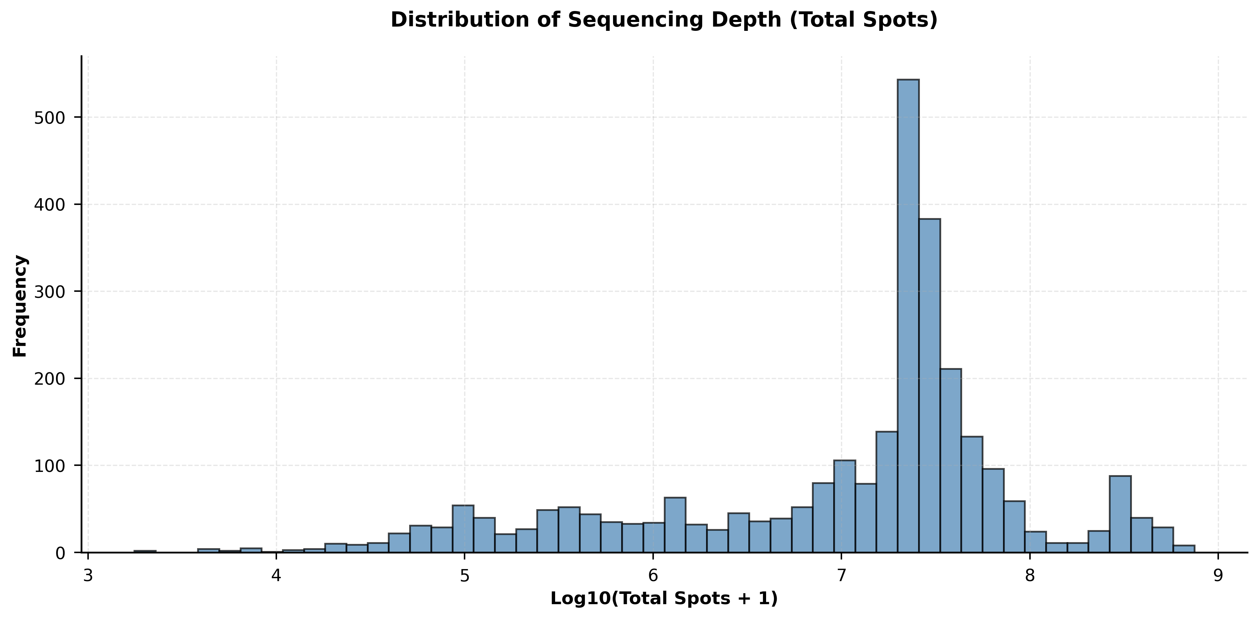
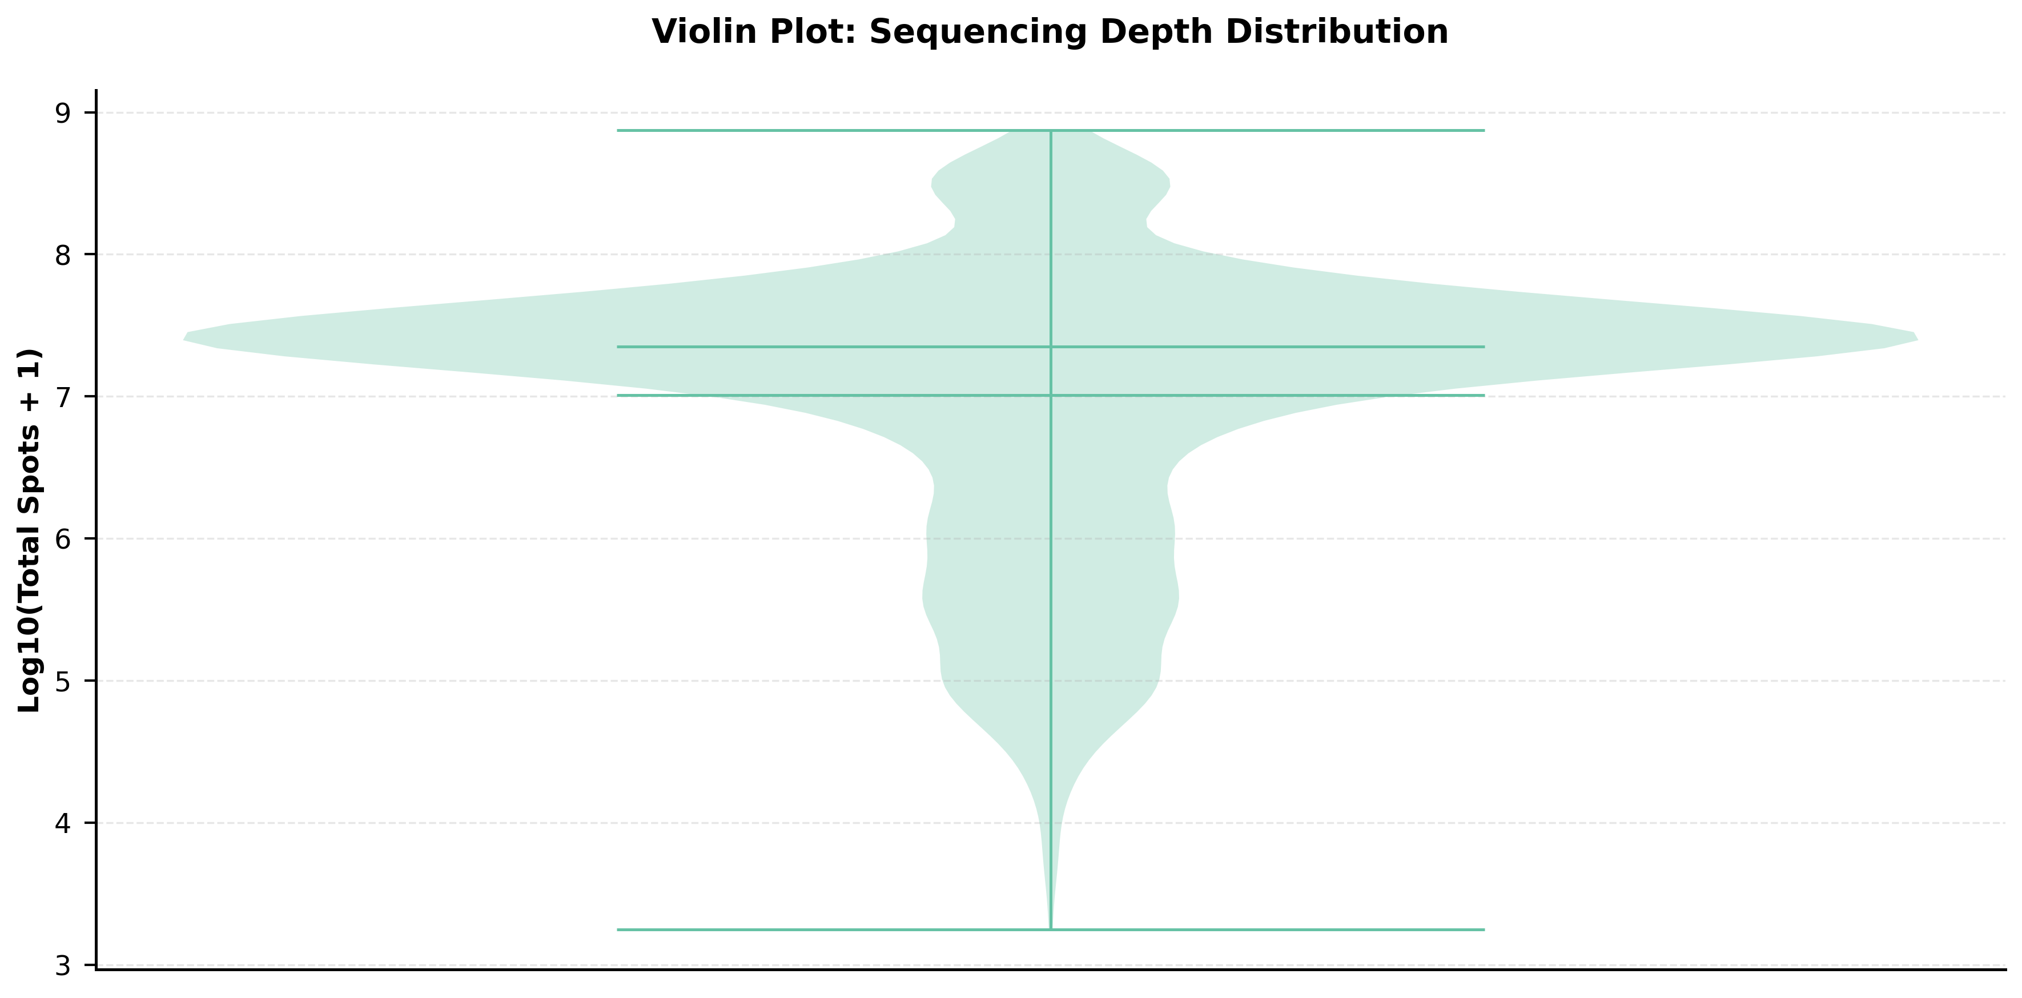
Sequencing Depth Analysis

Slide 9
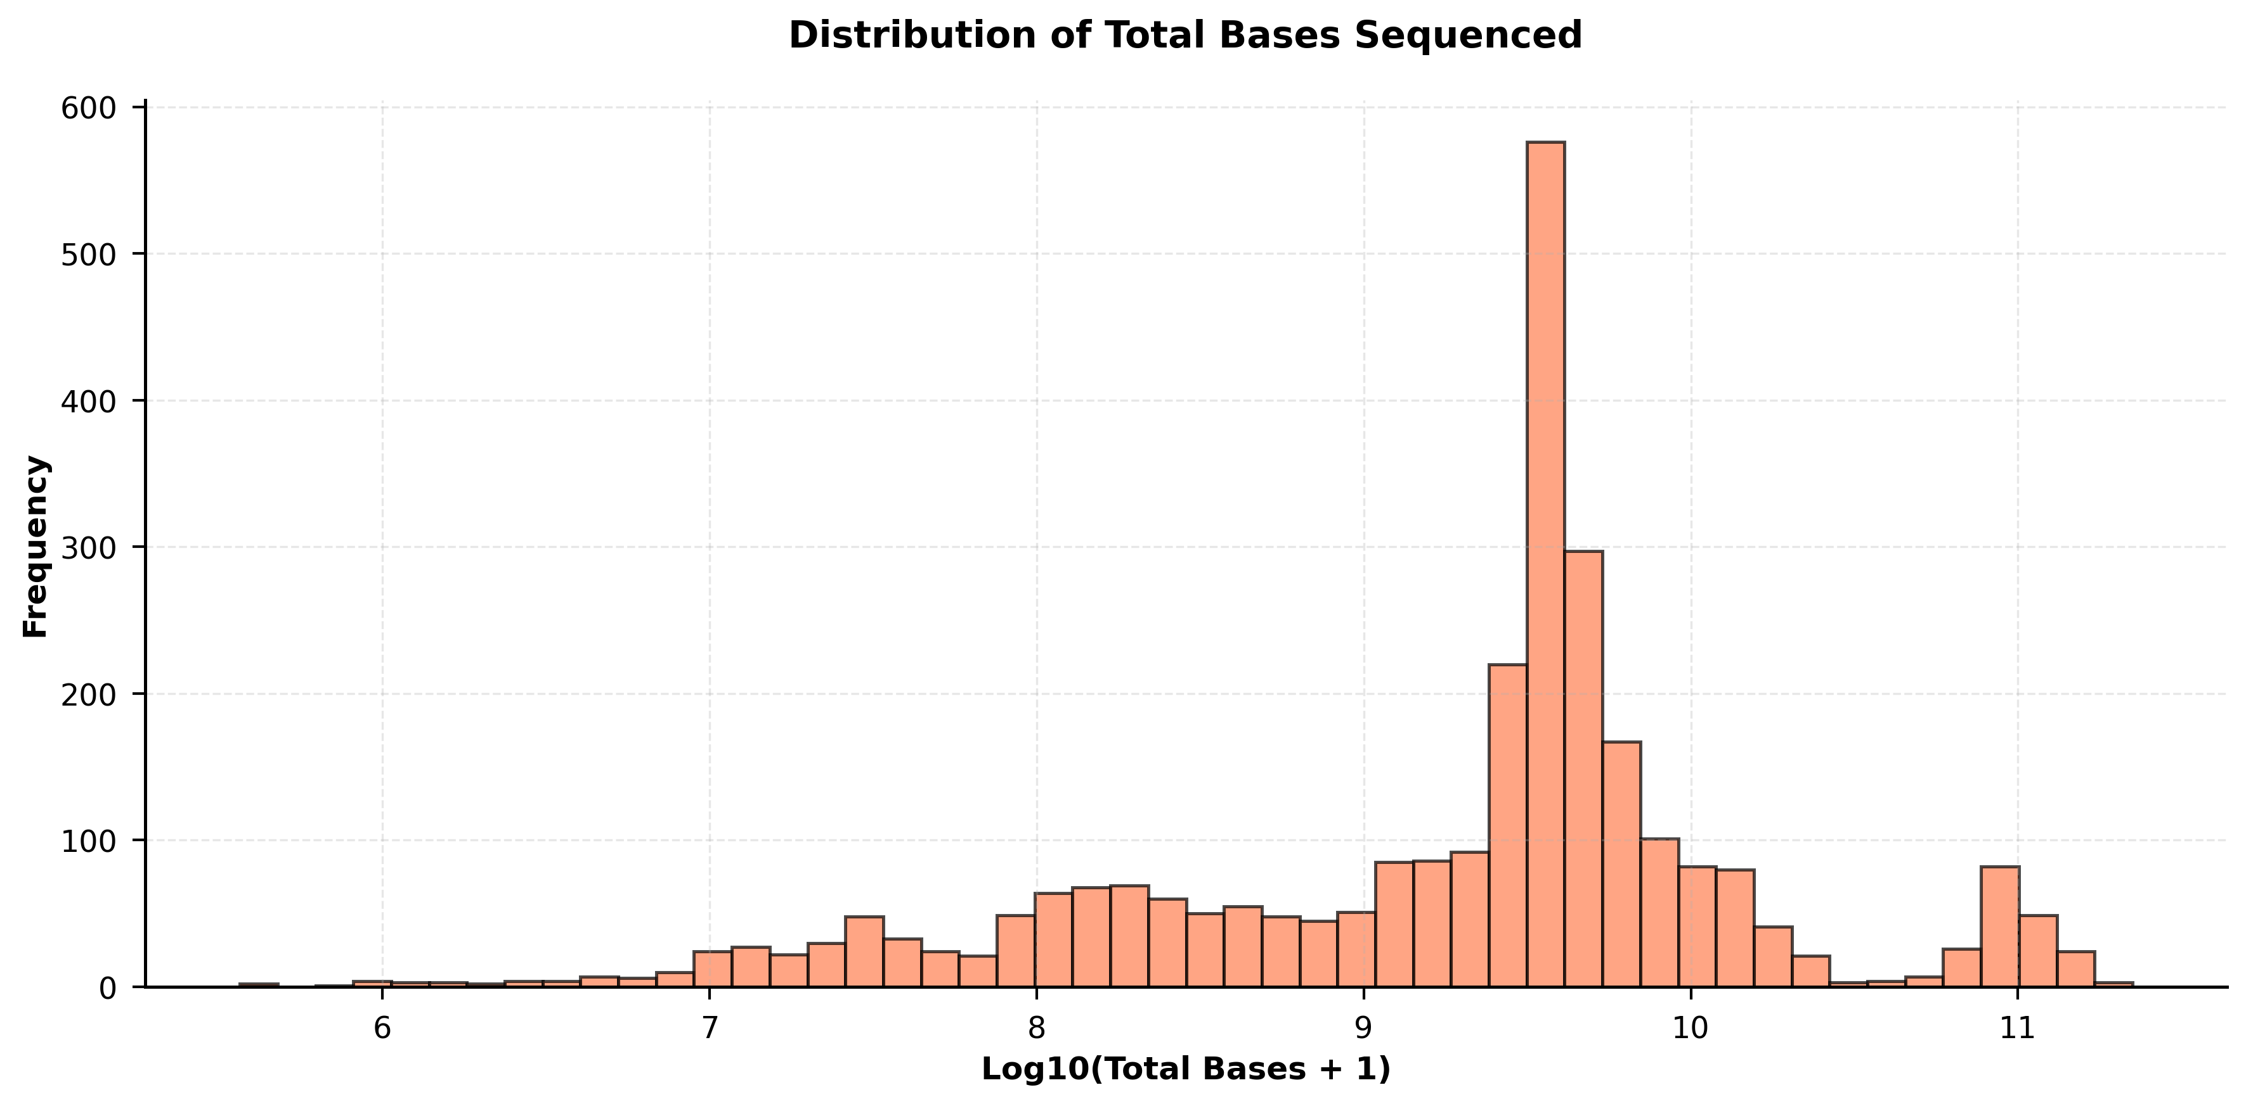
Sequencing Depth Analysis

Slide 10
Sample Demographics

Slide 11
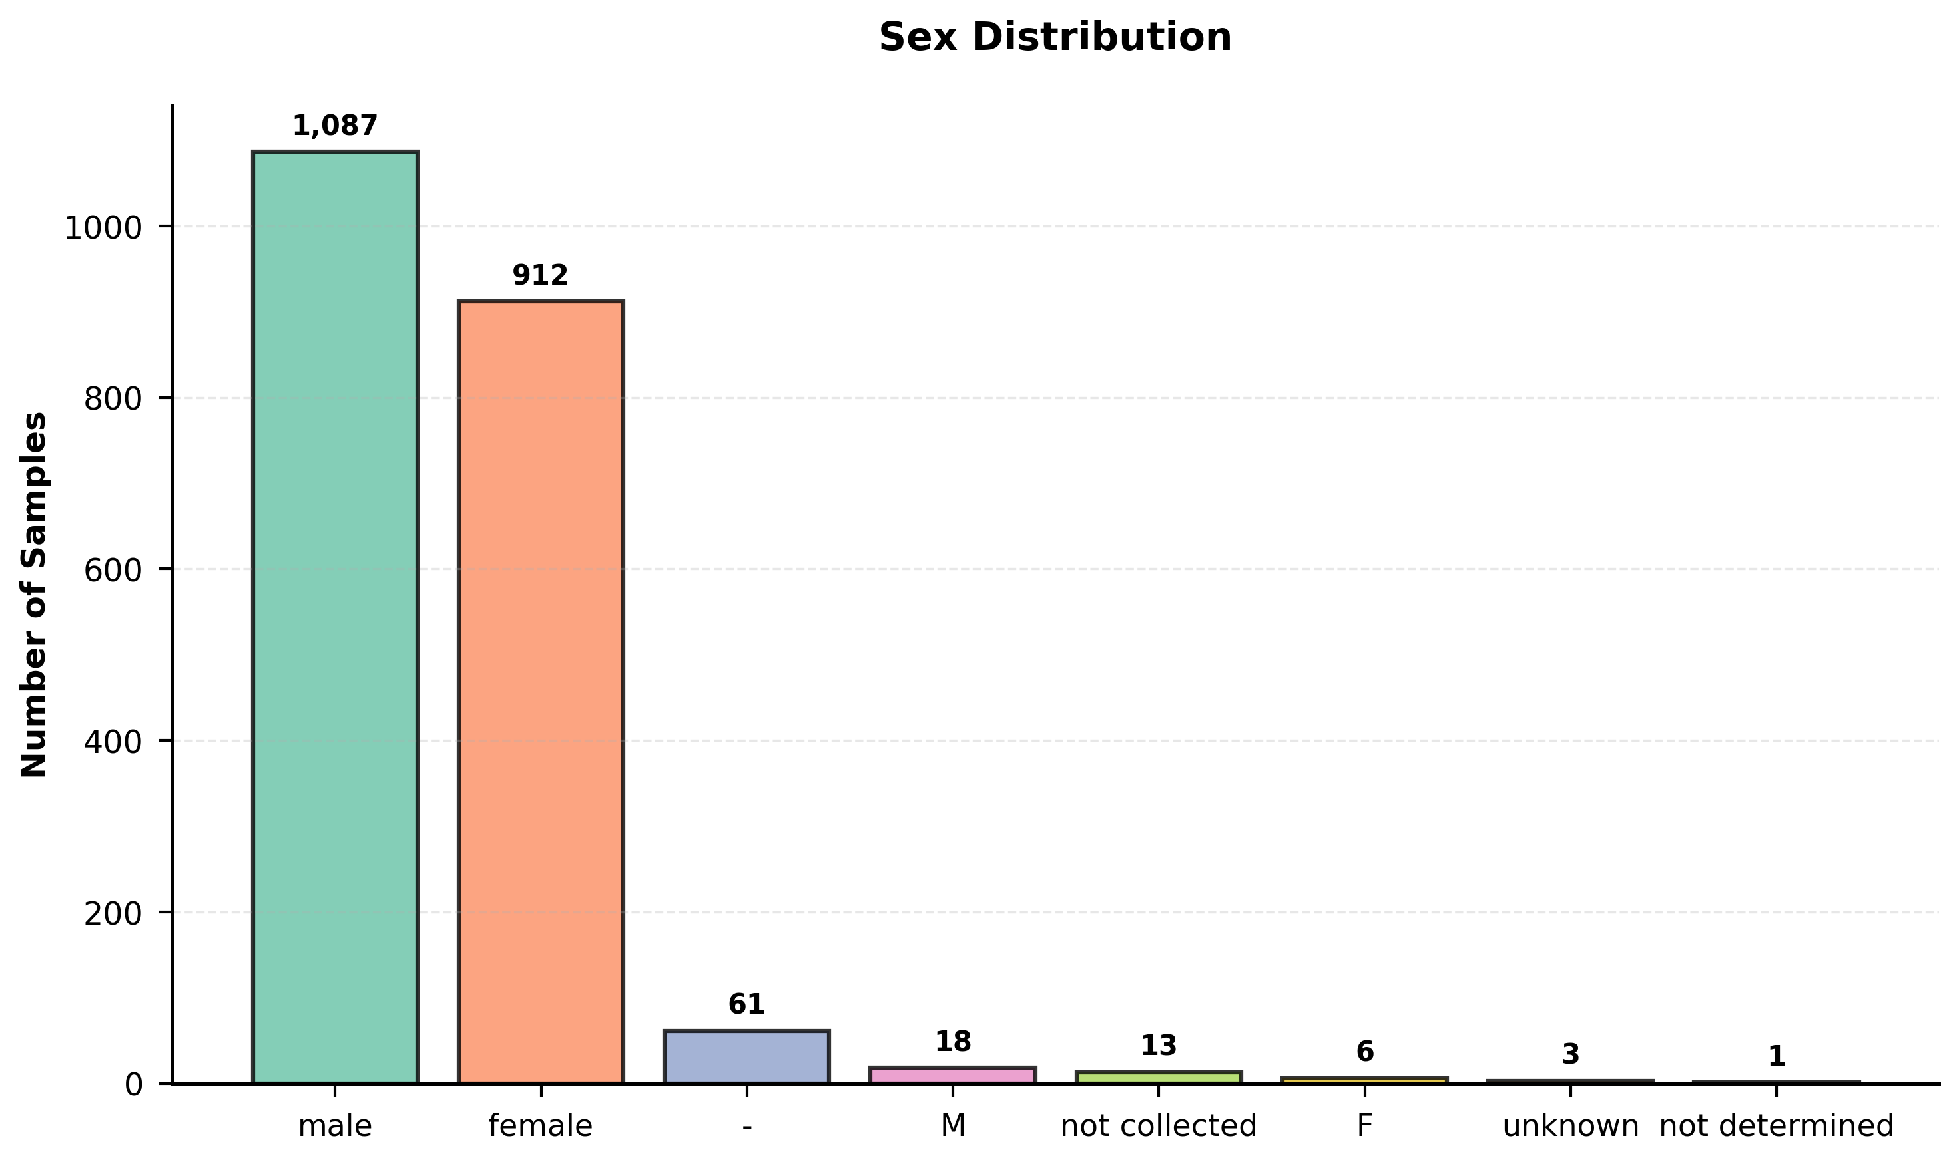
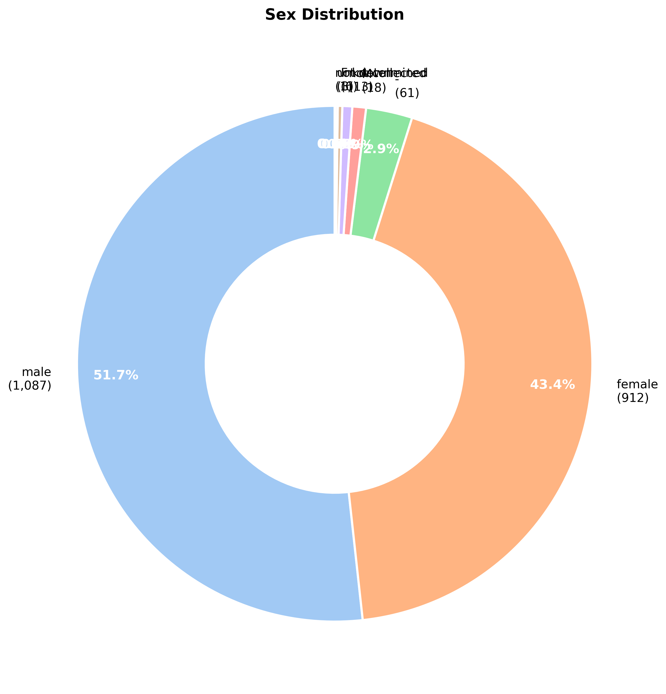
Sample Demographics

Slide 12
Metadata Completeness

Slide 13
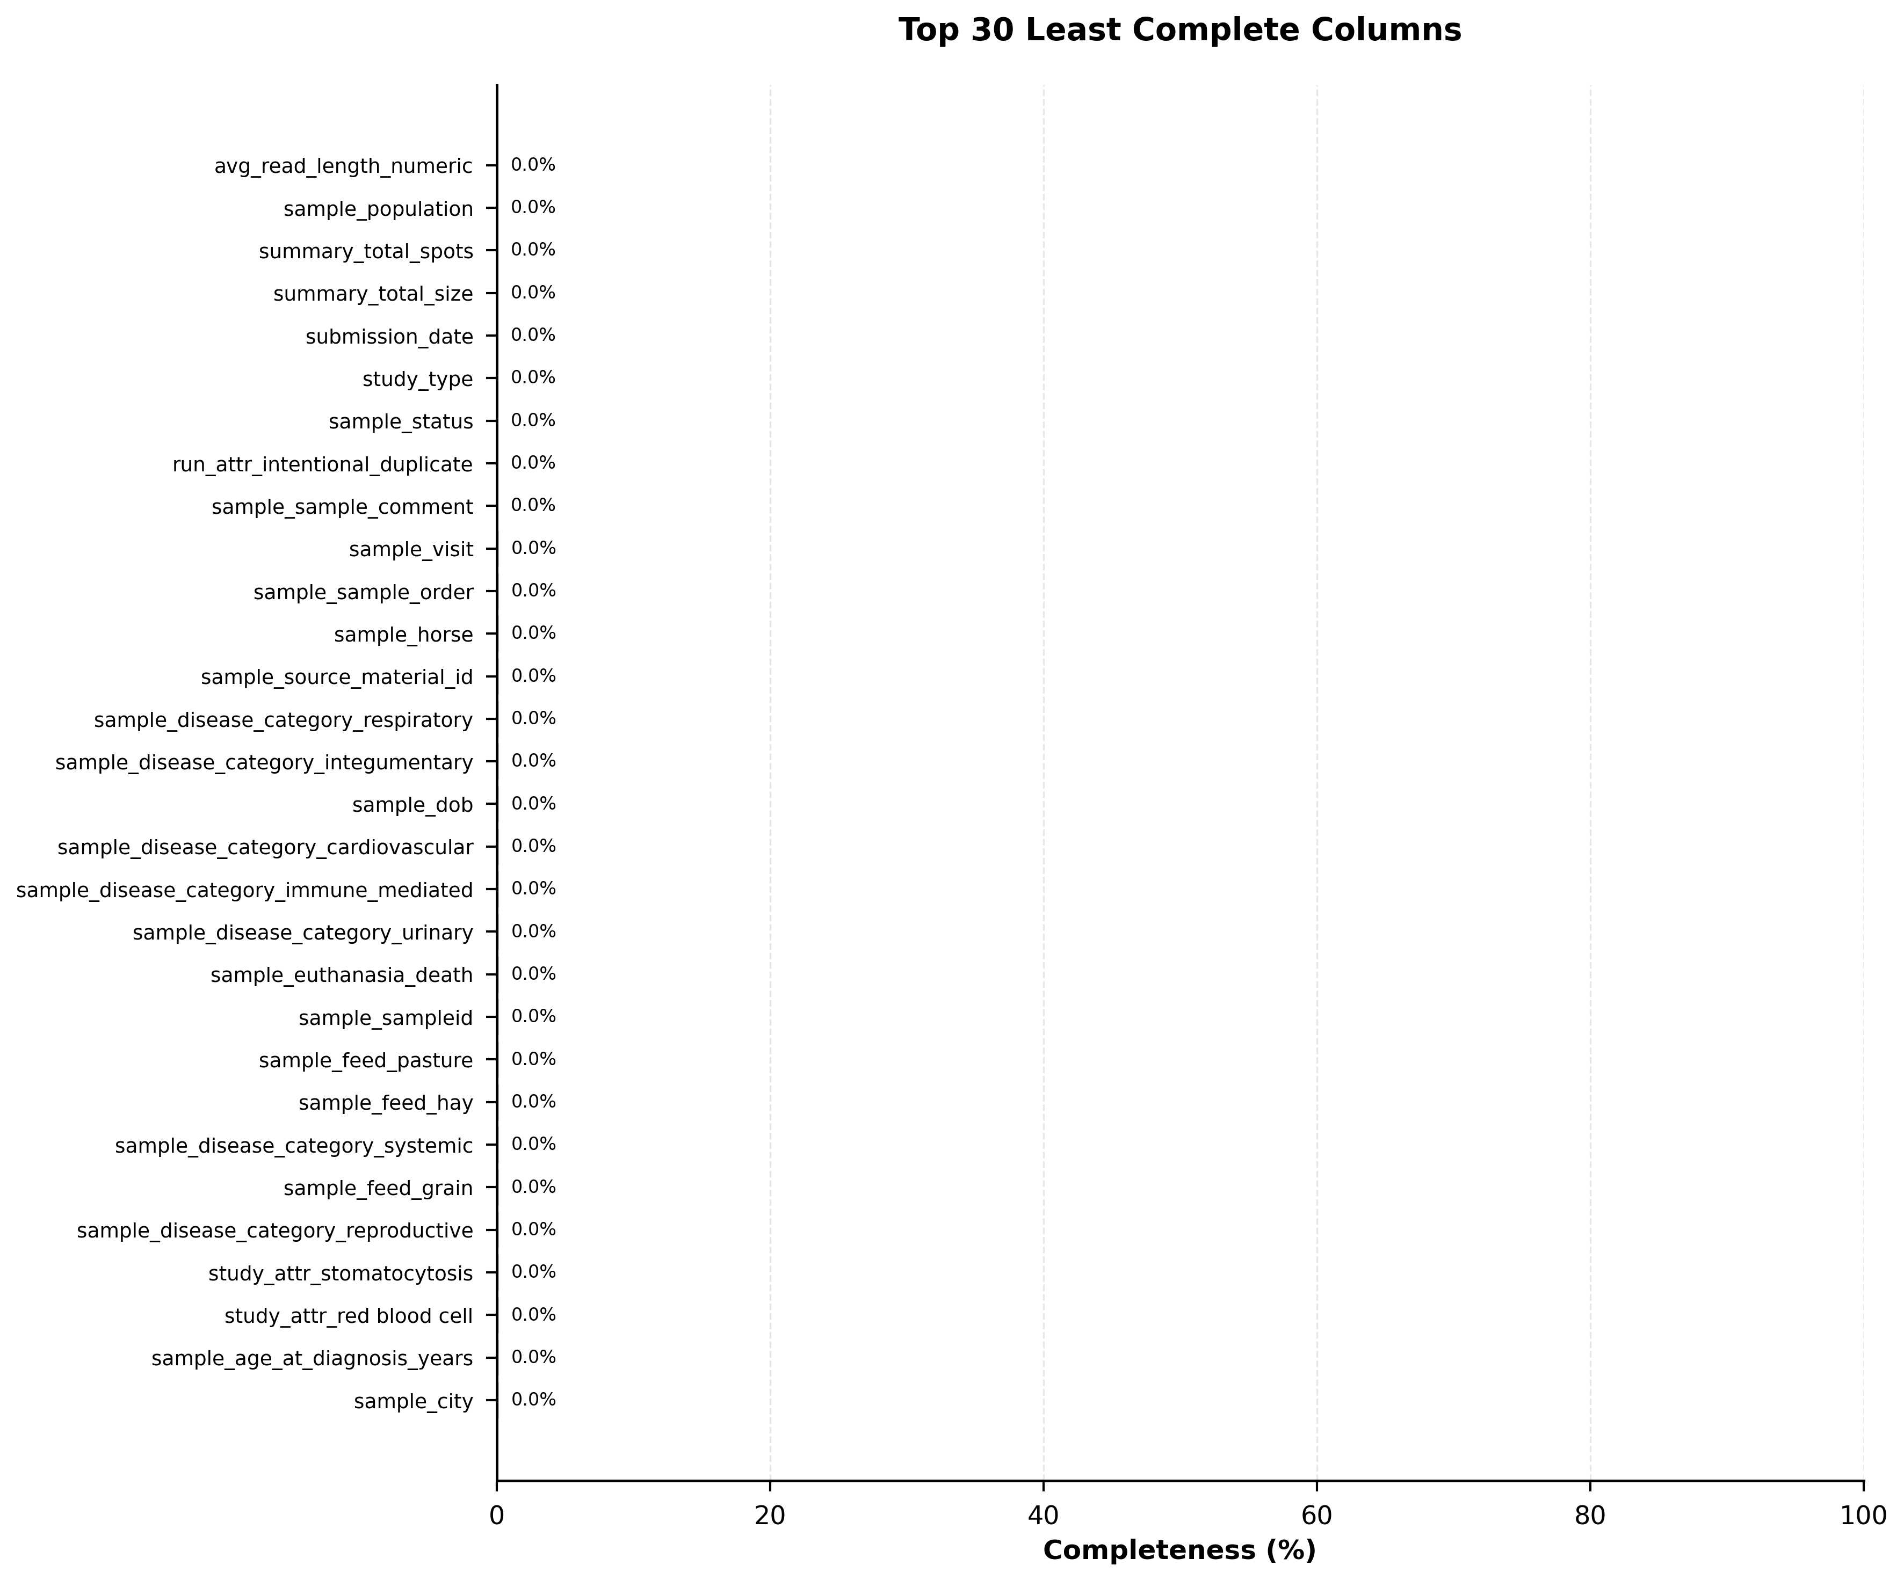
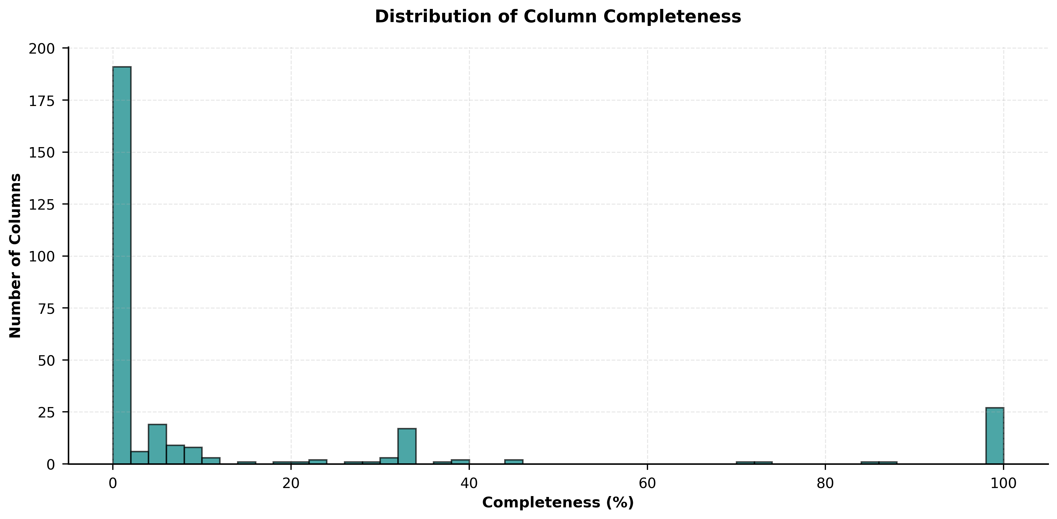
Metadata Completeness

Slide 14
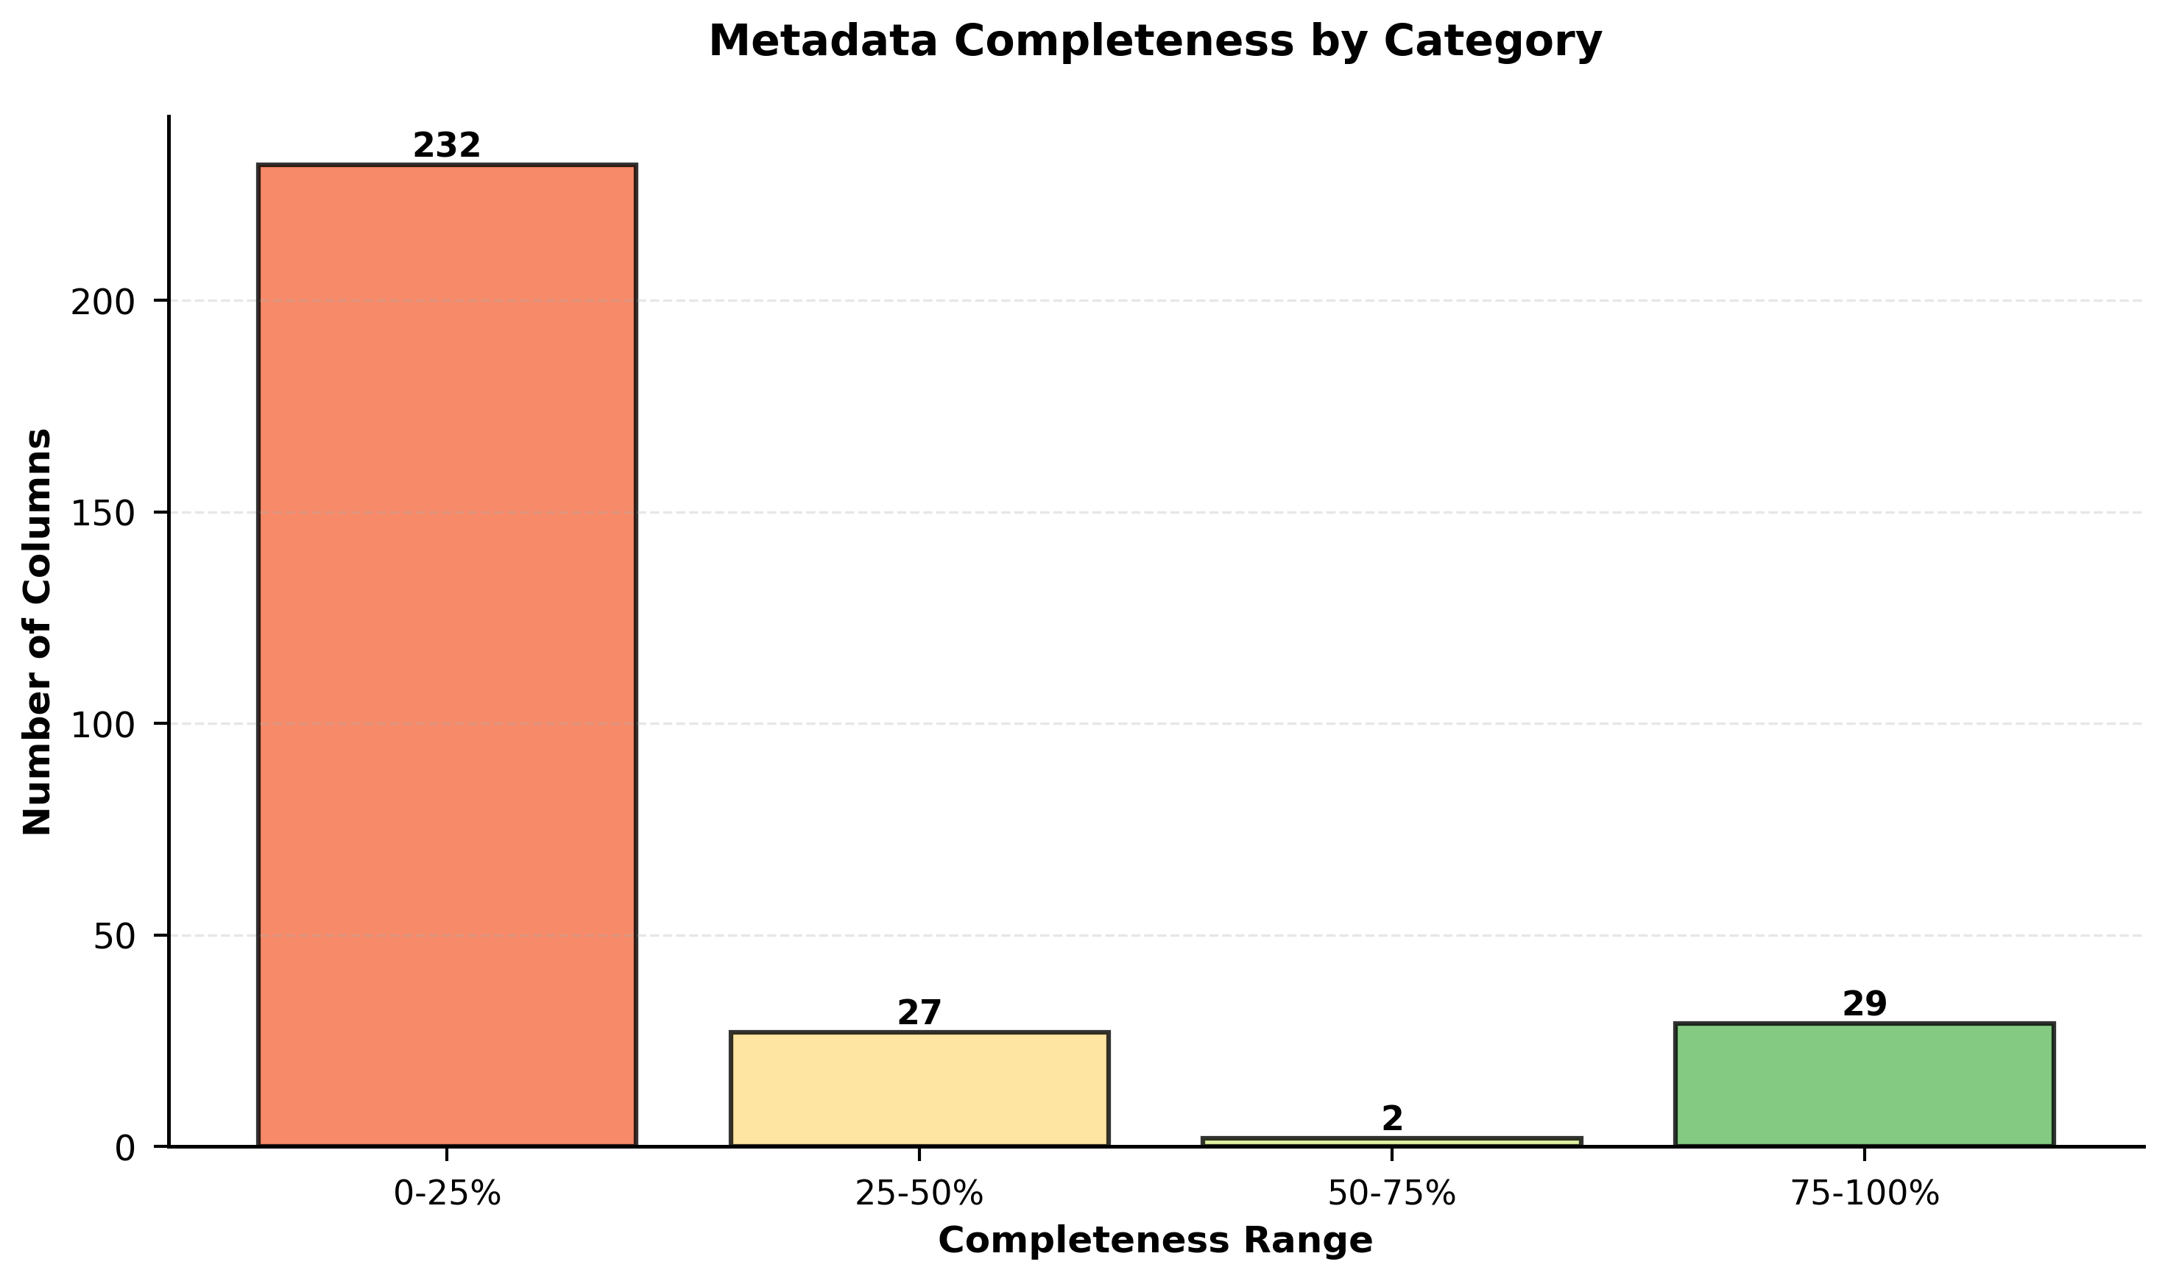
Metadata Completeness

Slide 15
Contributing Organizations

Slide 16
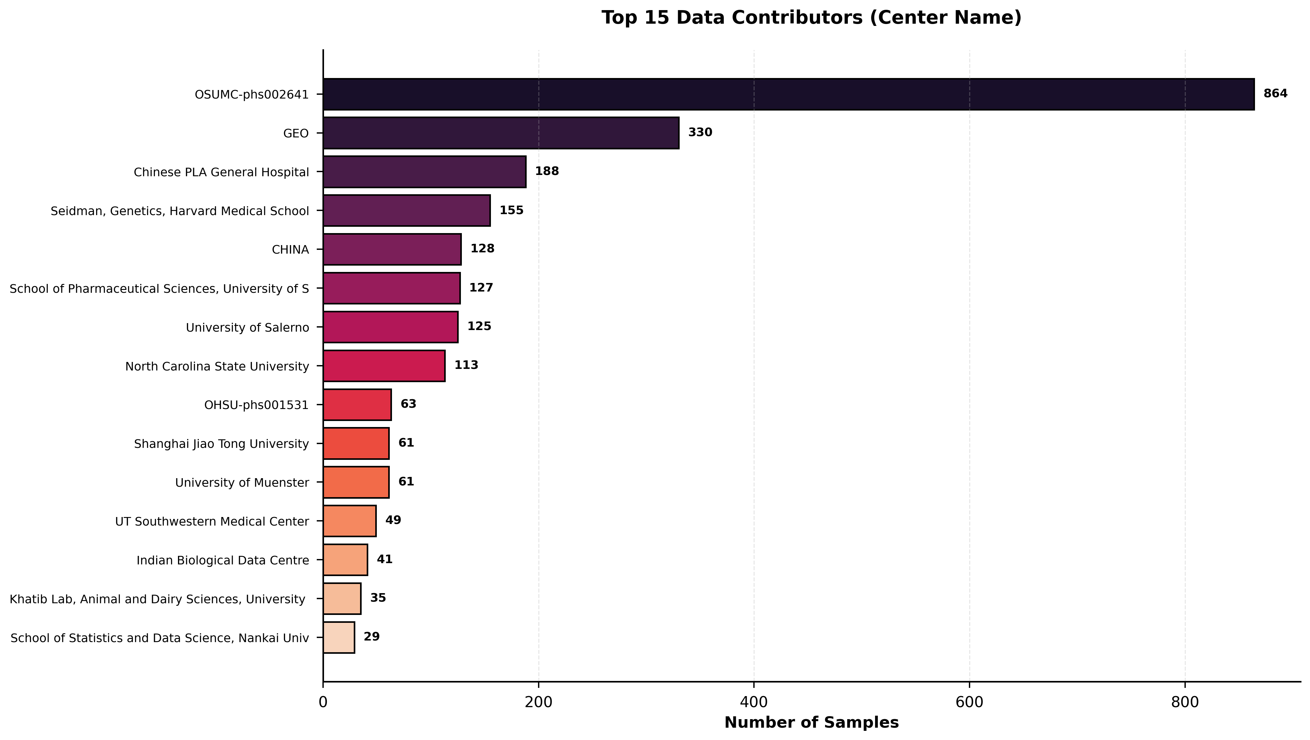
Contributing Organizations

Slide 17
Data Correlations

Slide 18
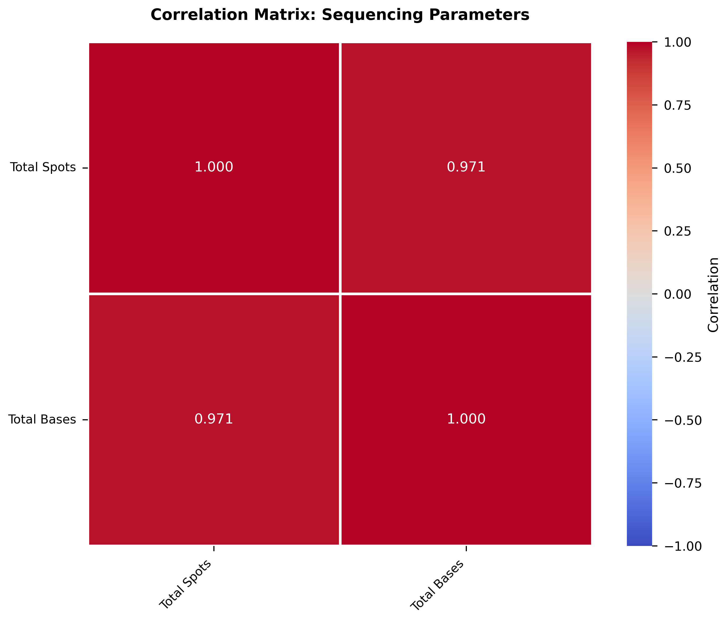
Data Correlations

Slide 19
Disease Distribution

Slide 20
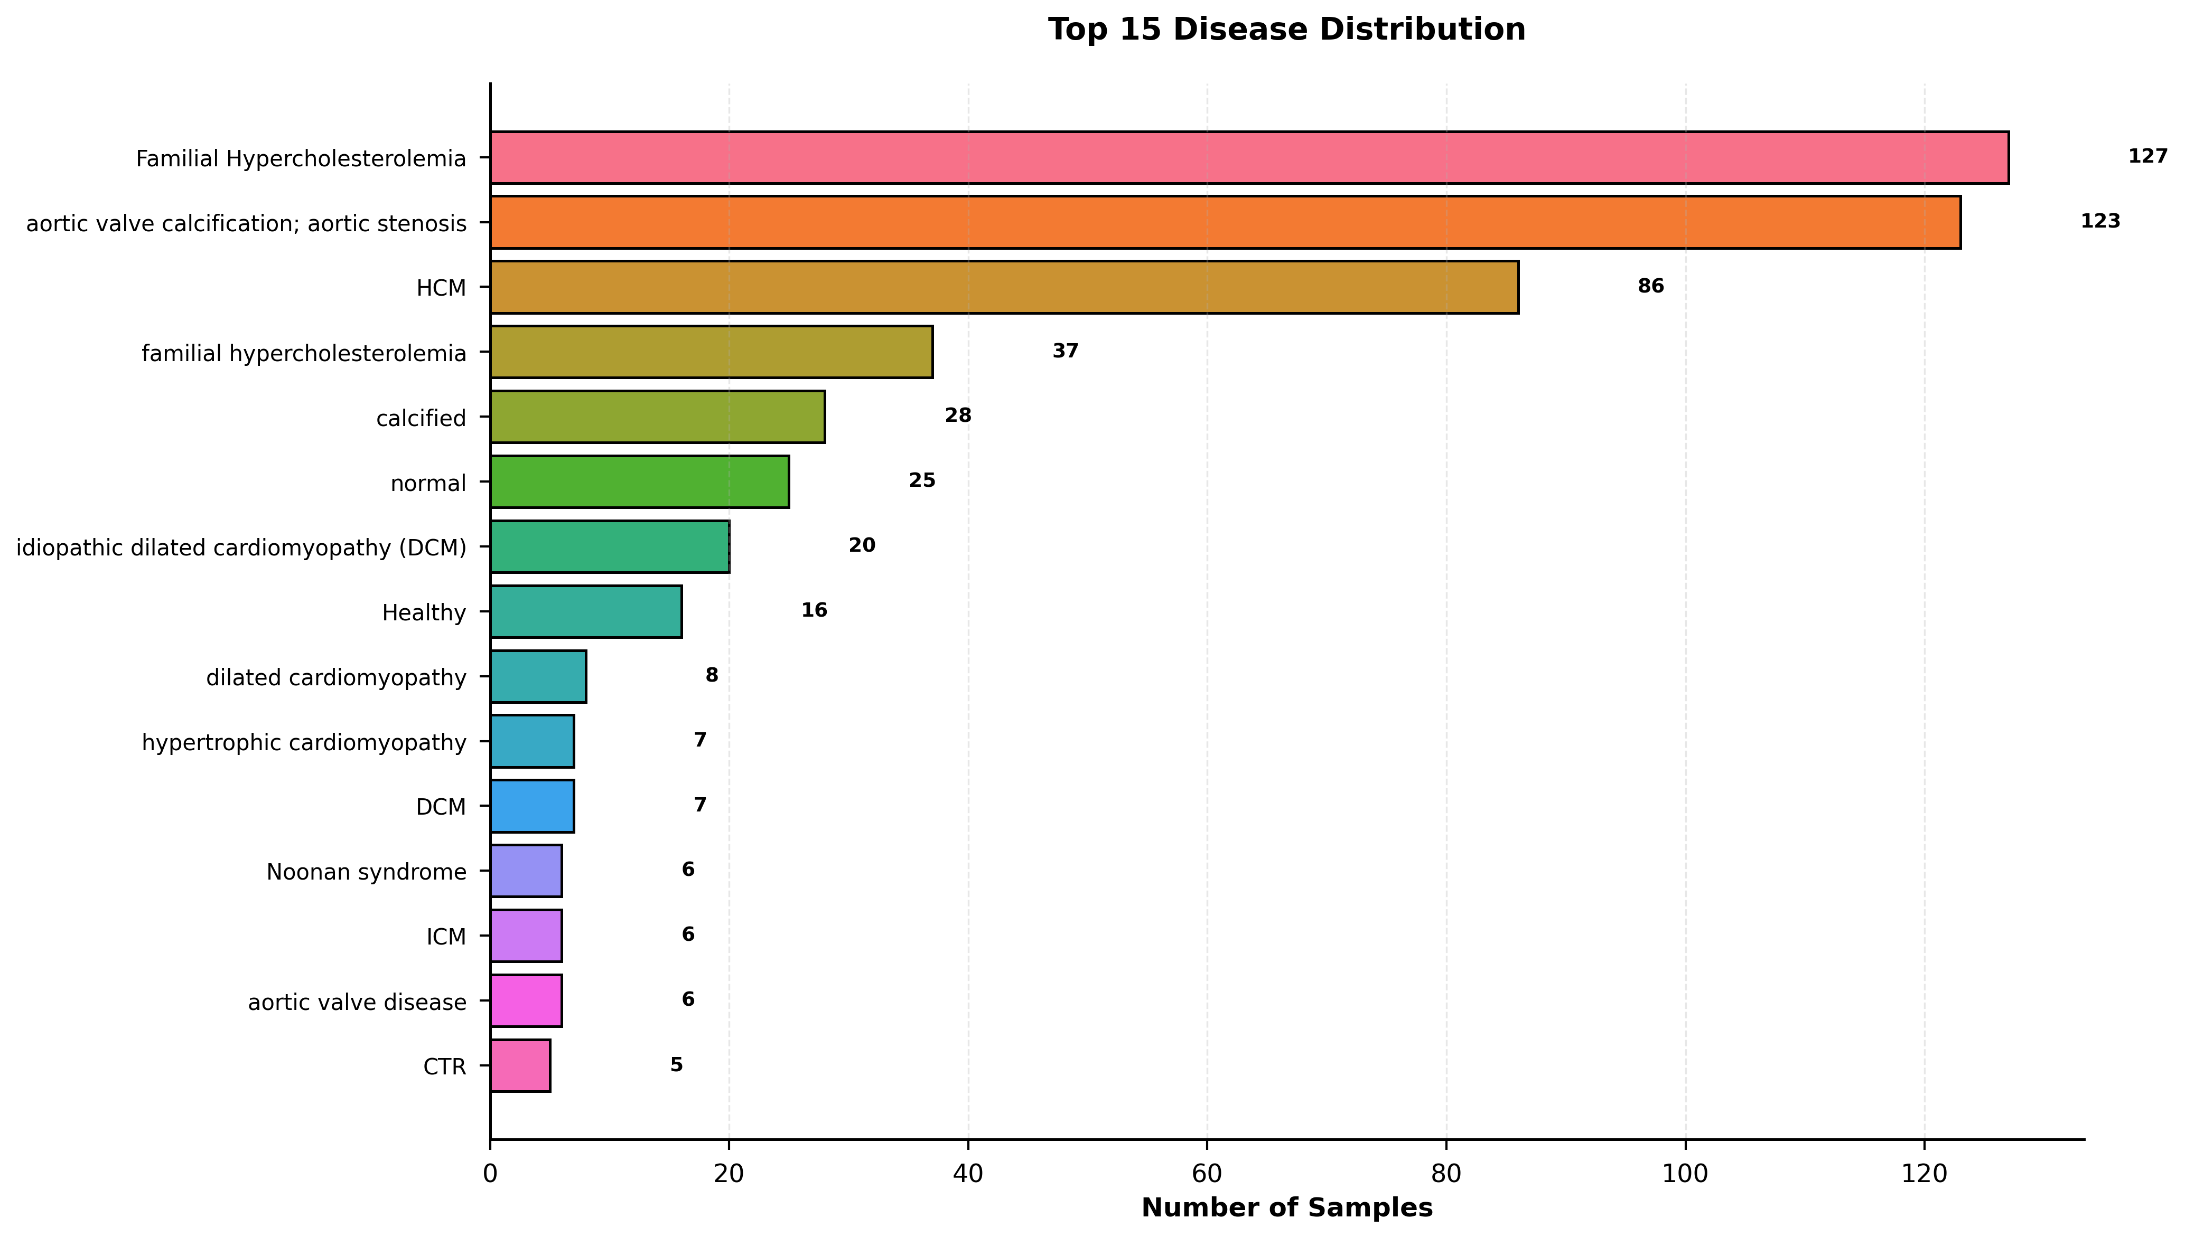
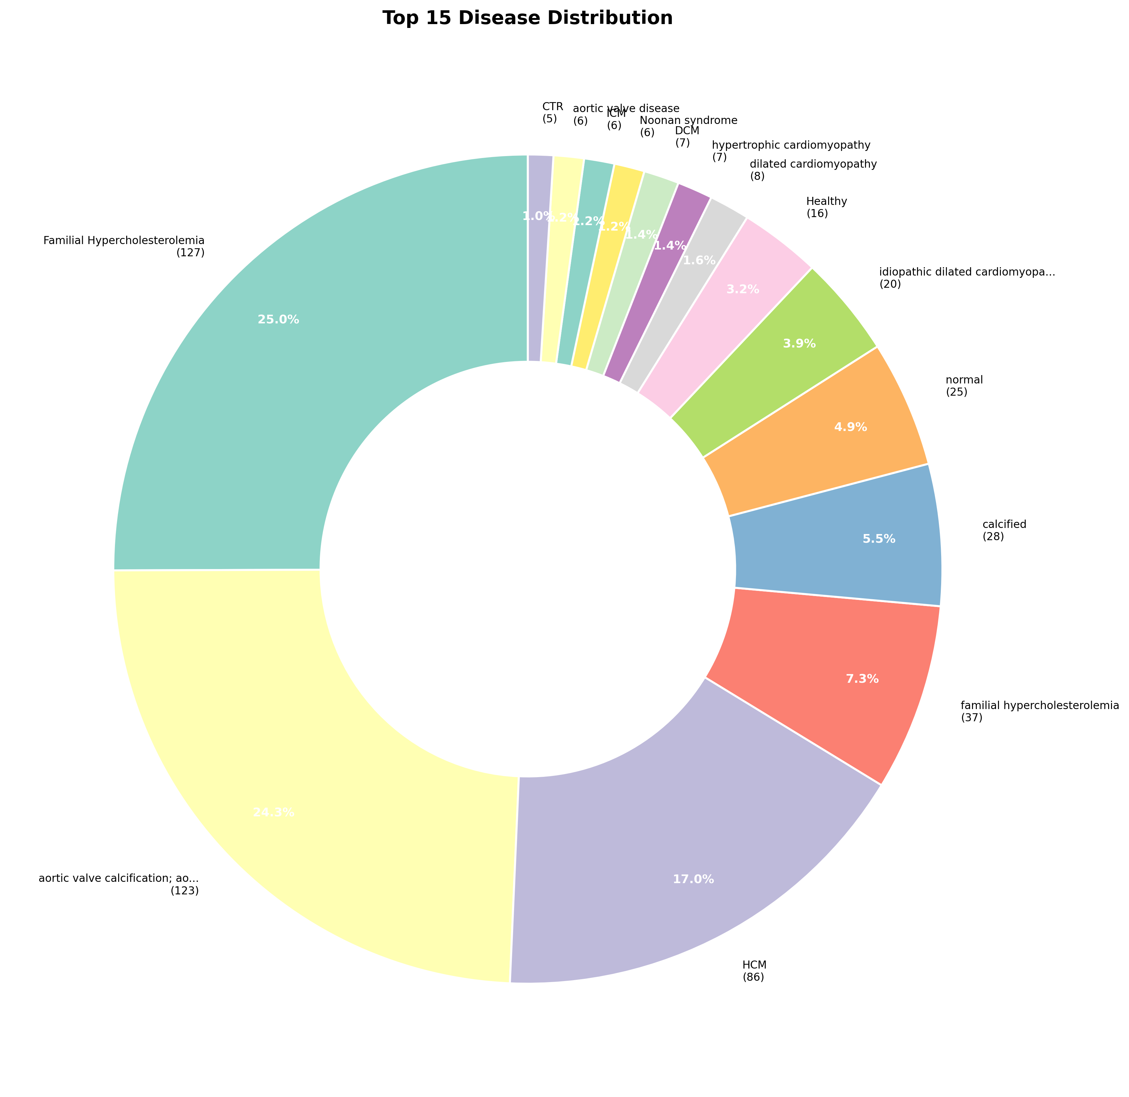
Disease Distribution

Slide 21
Tissue Types

Slide 22
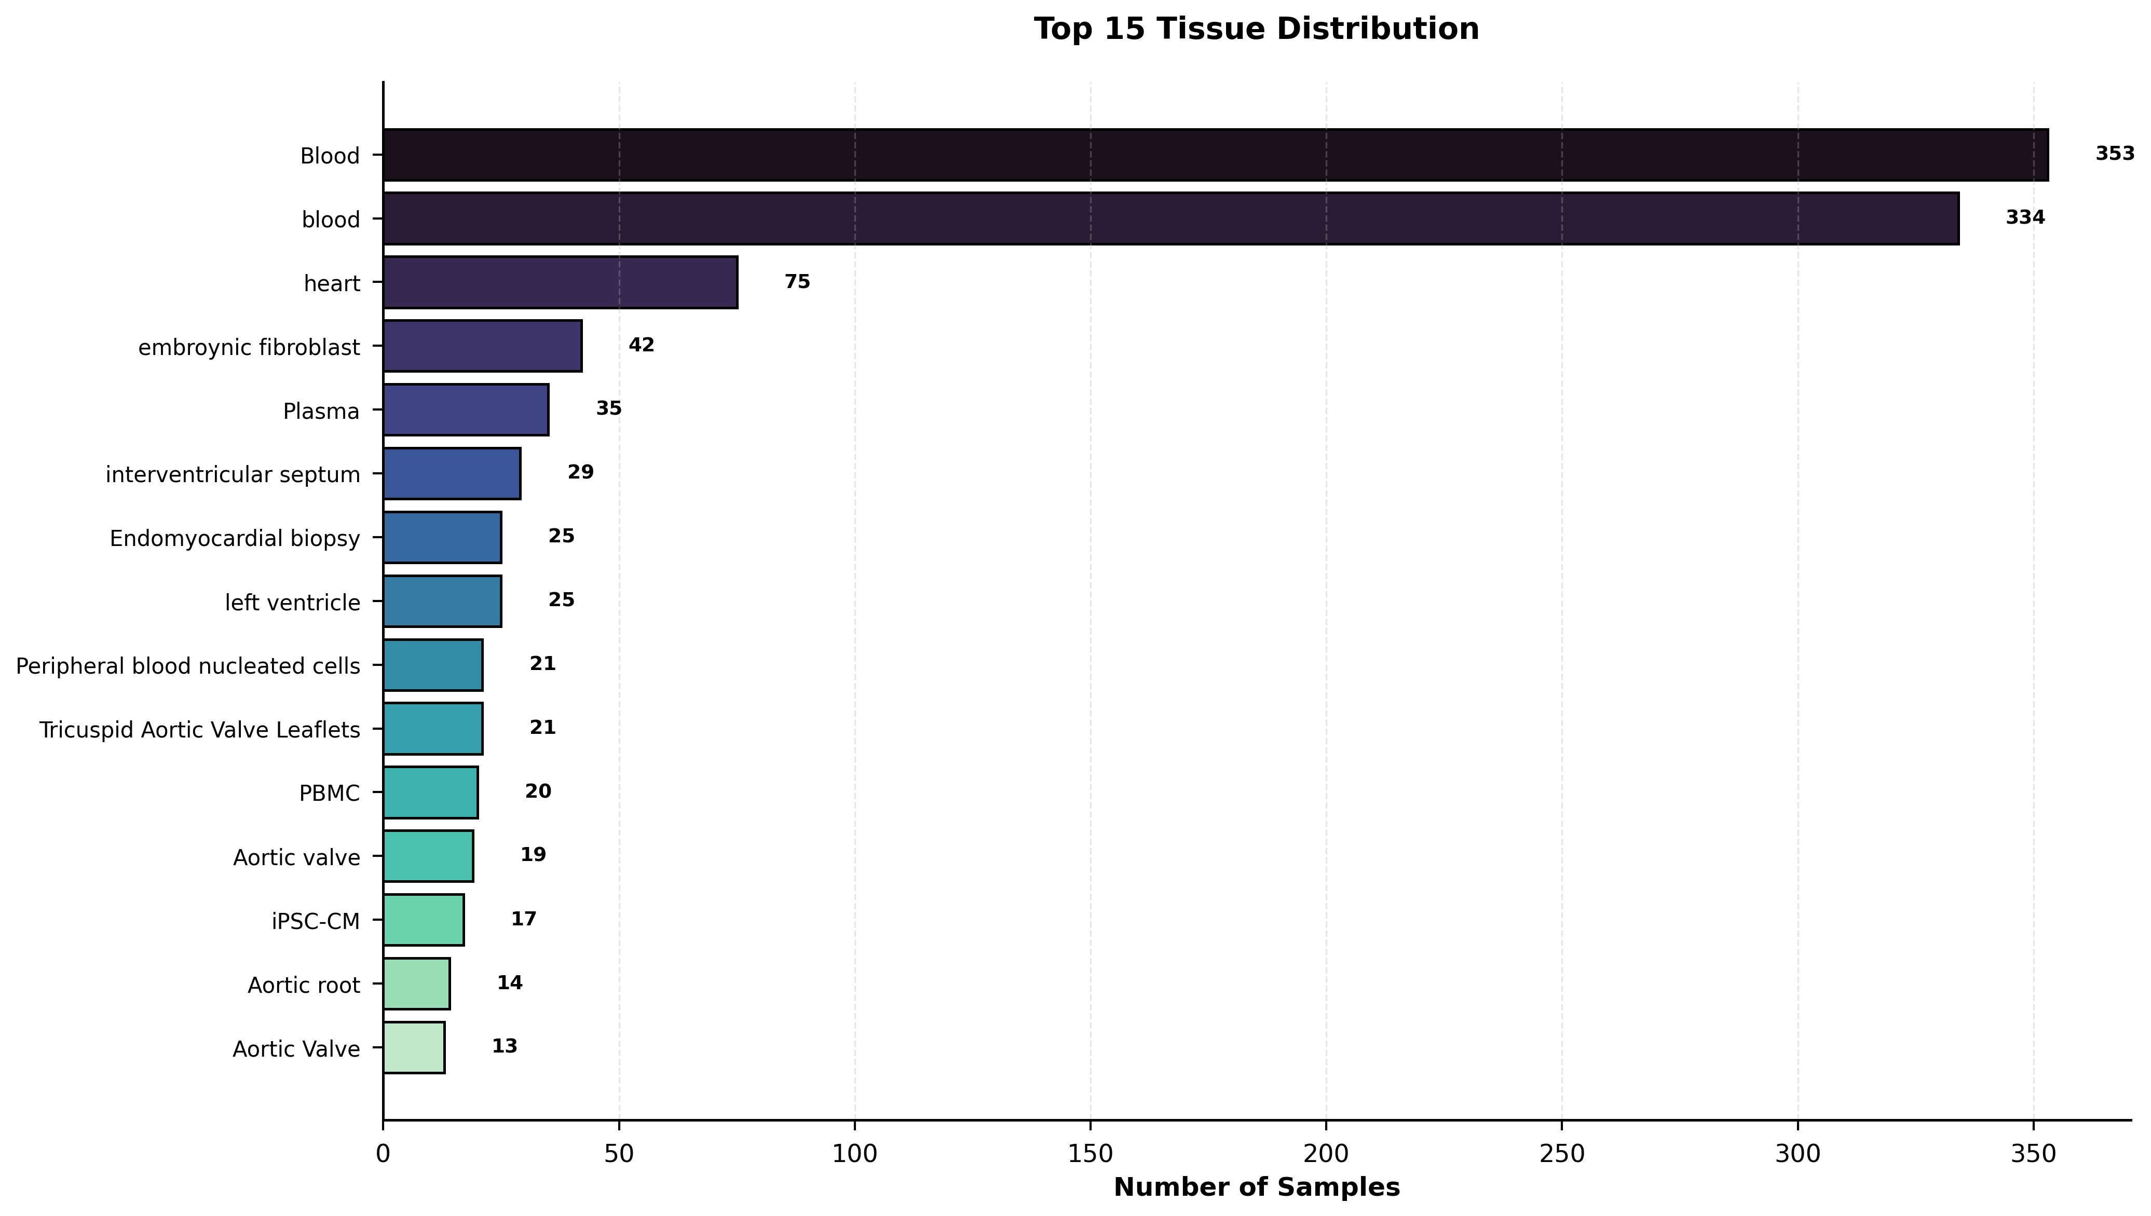
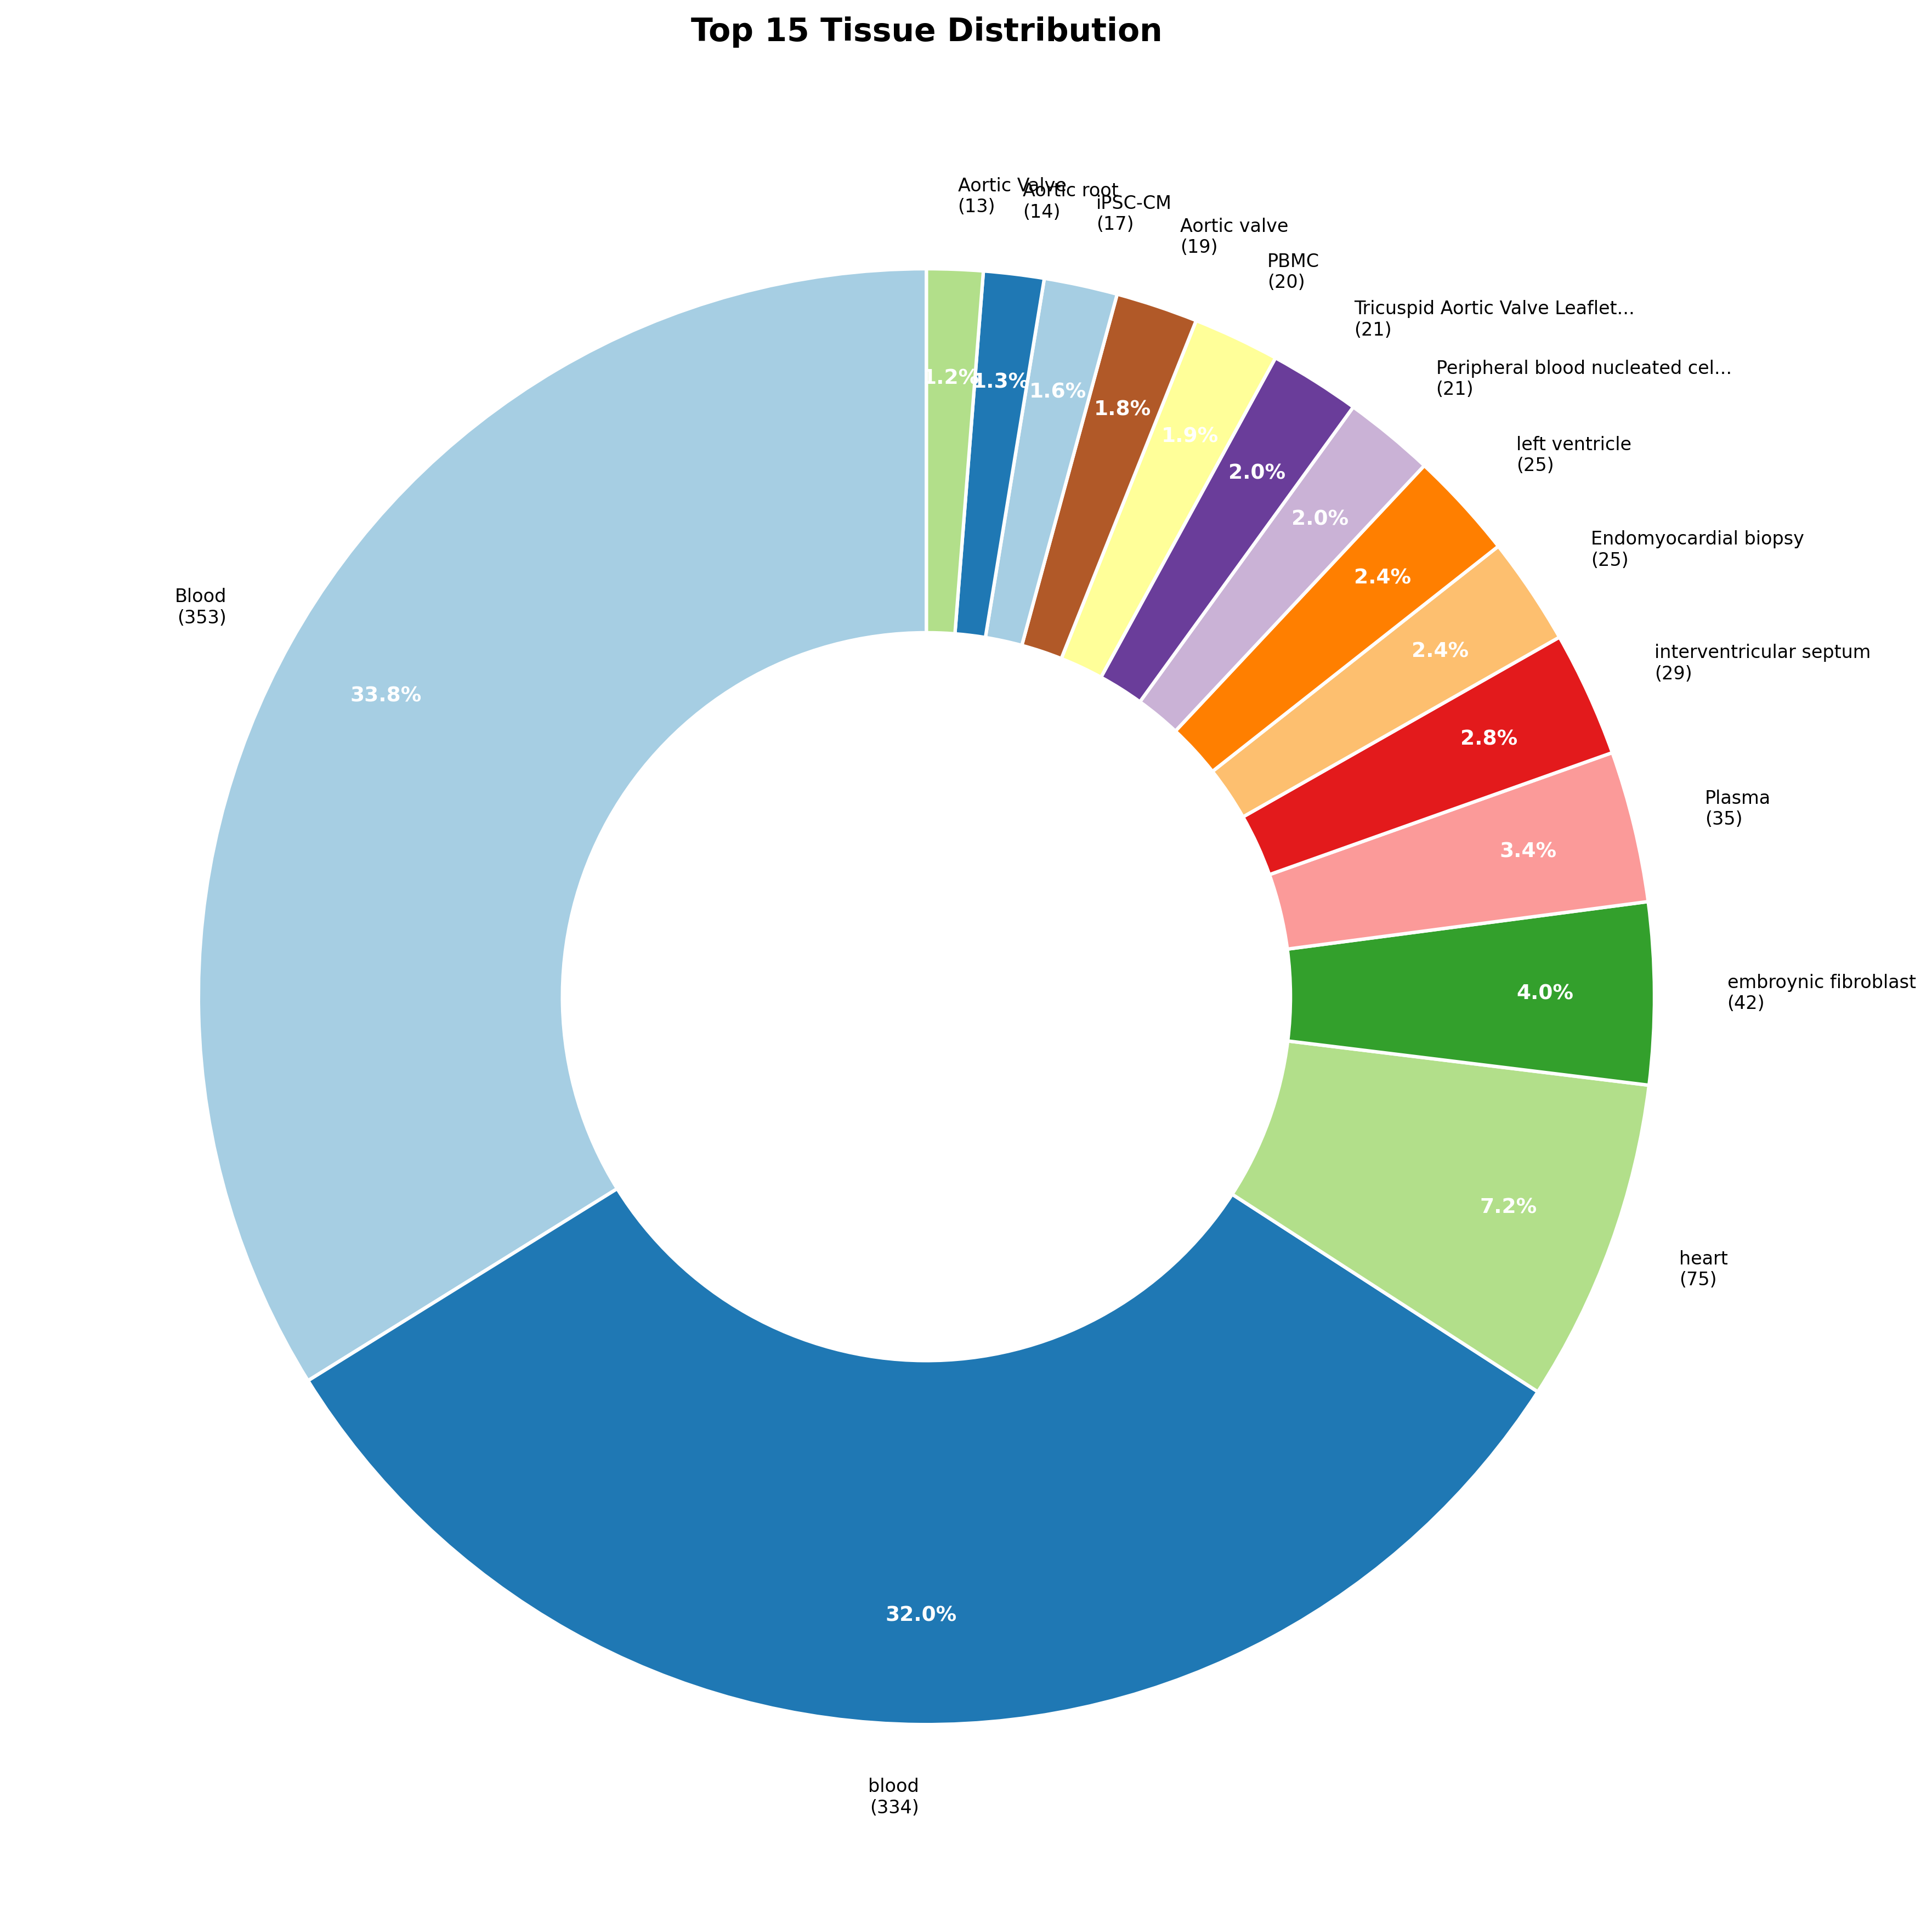
Tissue Types

Slide 23
Correlation Analysis

Slide 24
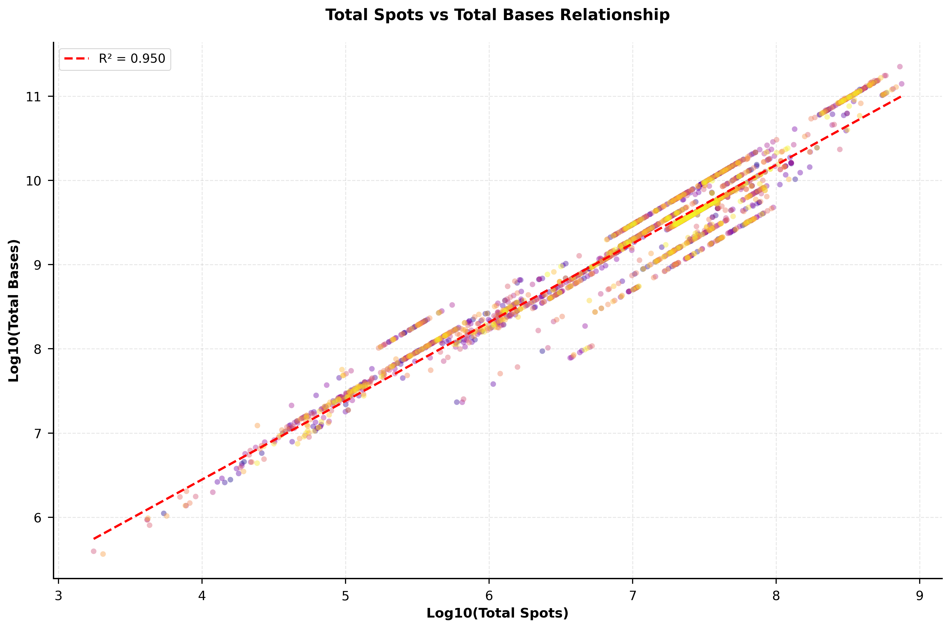
Correlation Analysis

Slide 25
Study-Level Analysis

Slide 26
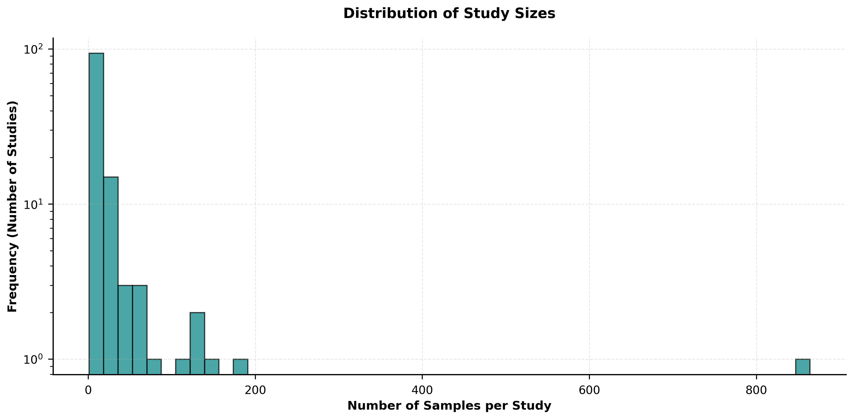
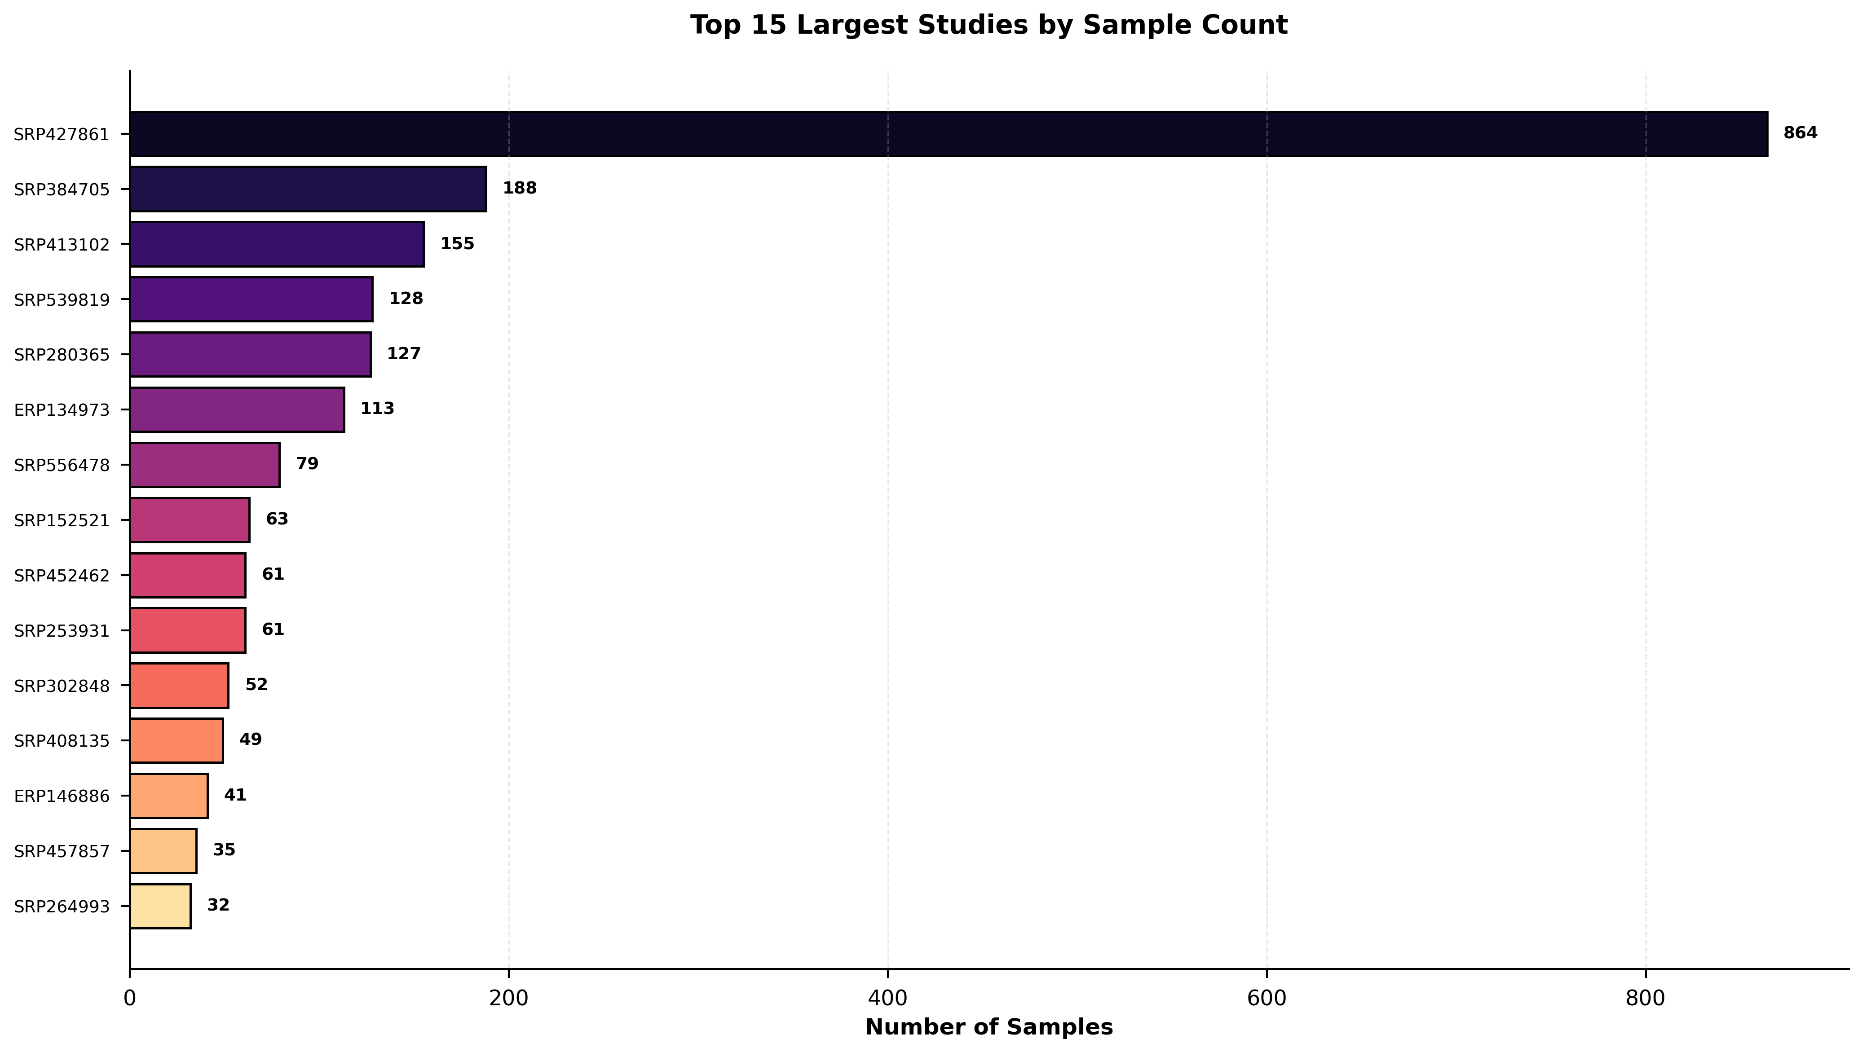
Study-Level Analysis

Slide 27
Library Layout Comparison

Slide 28
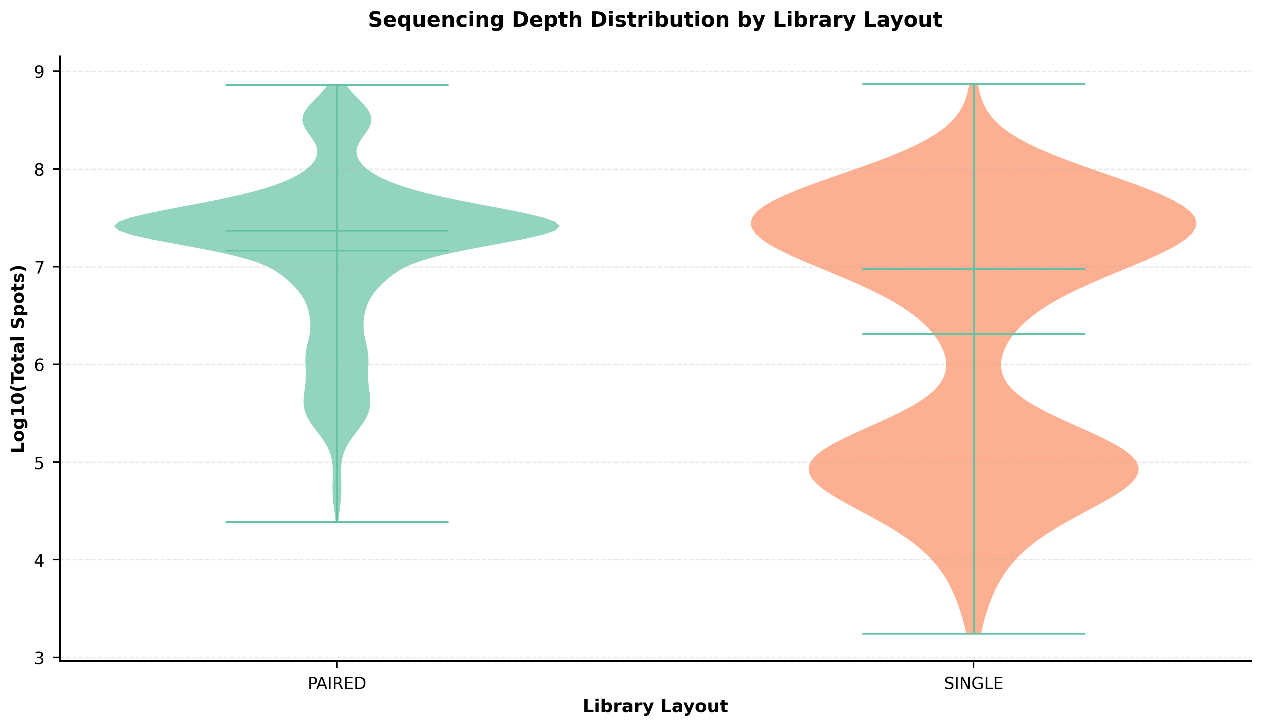
Library Layout Comparison

Slide 29
Patient Demographics Details

Slide 30
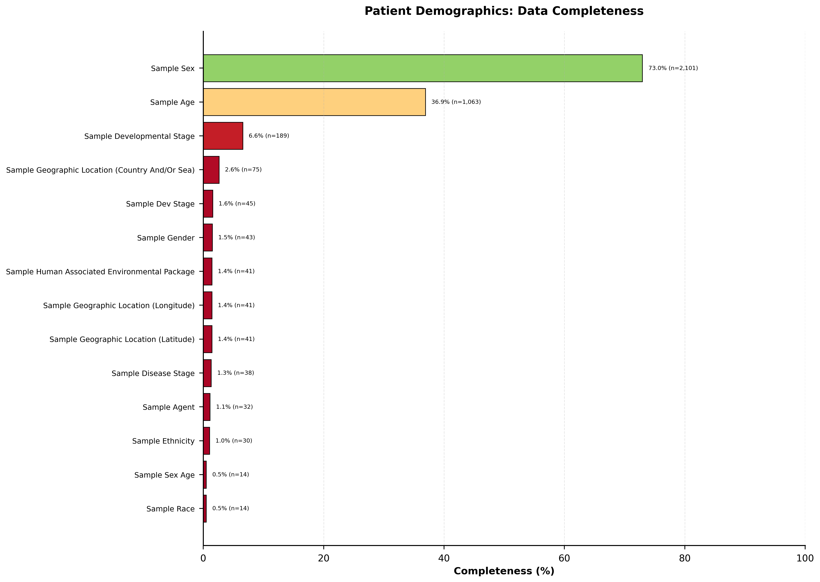
Patient Demographics Details

Slide 31
Column Categories

Slide 32
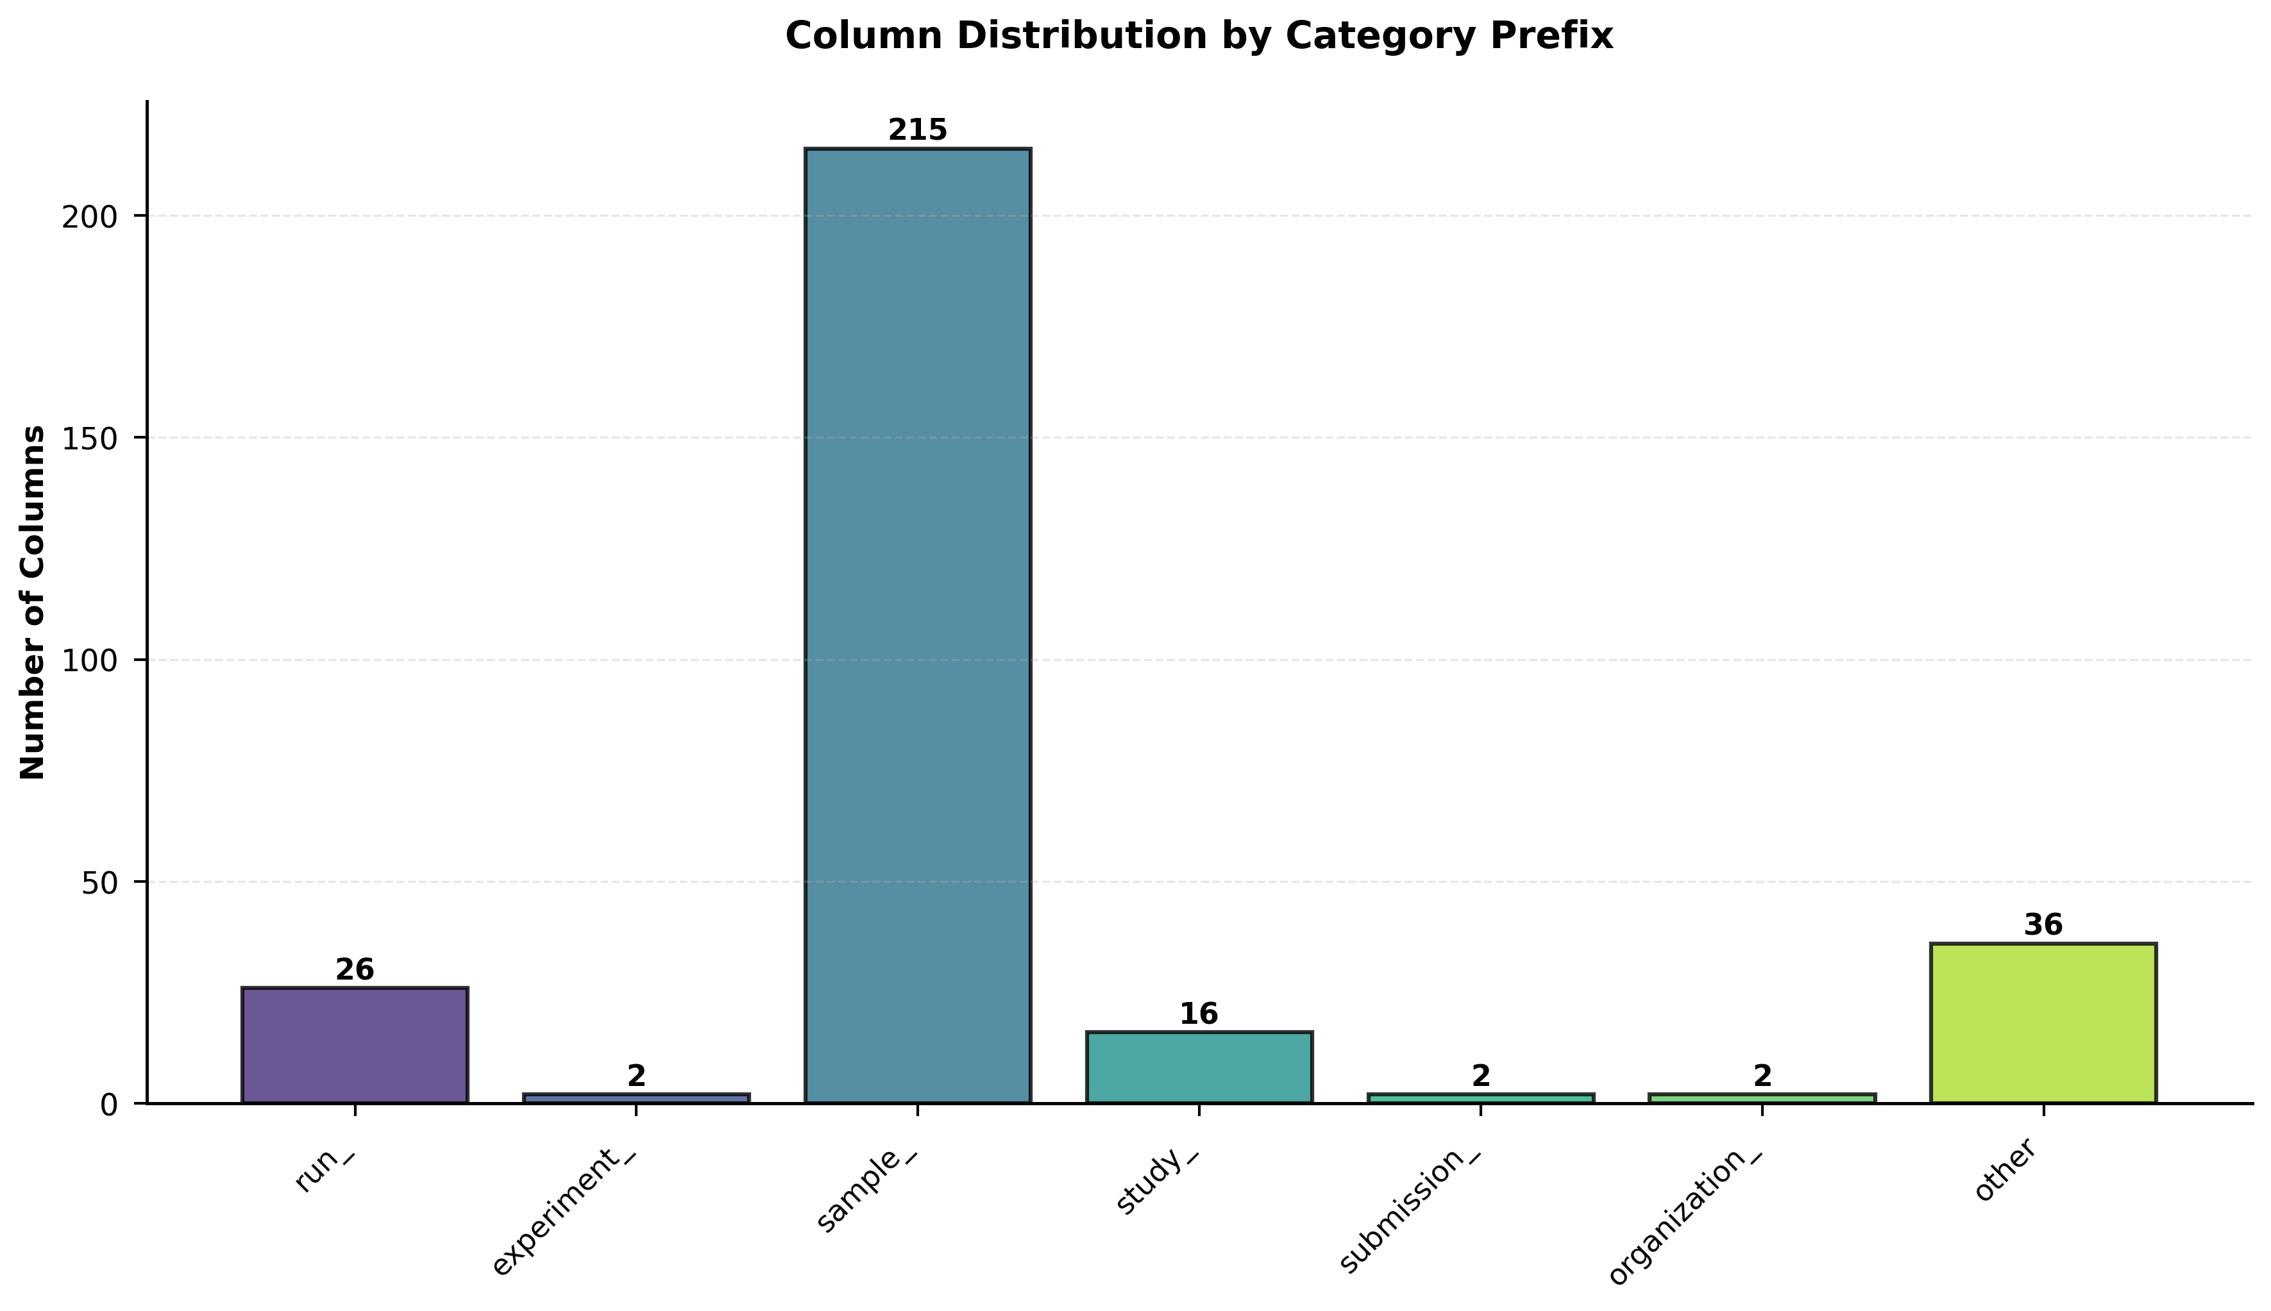
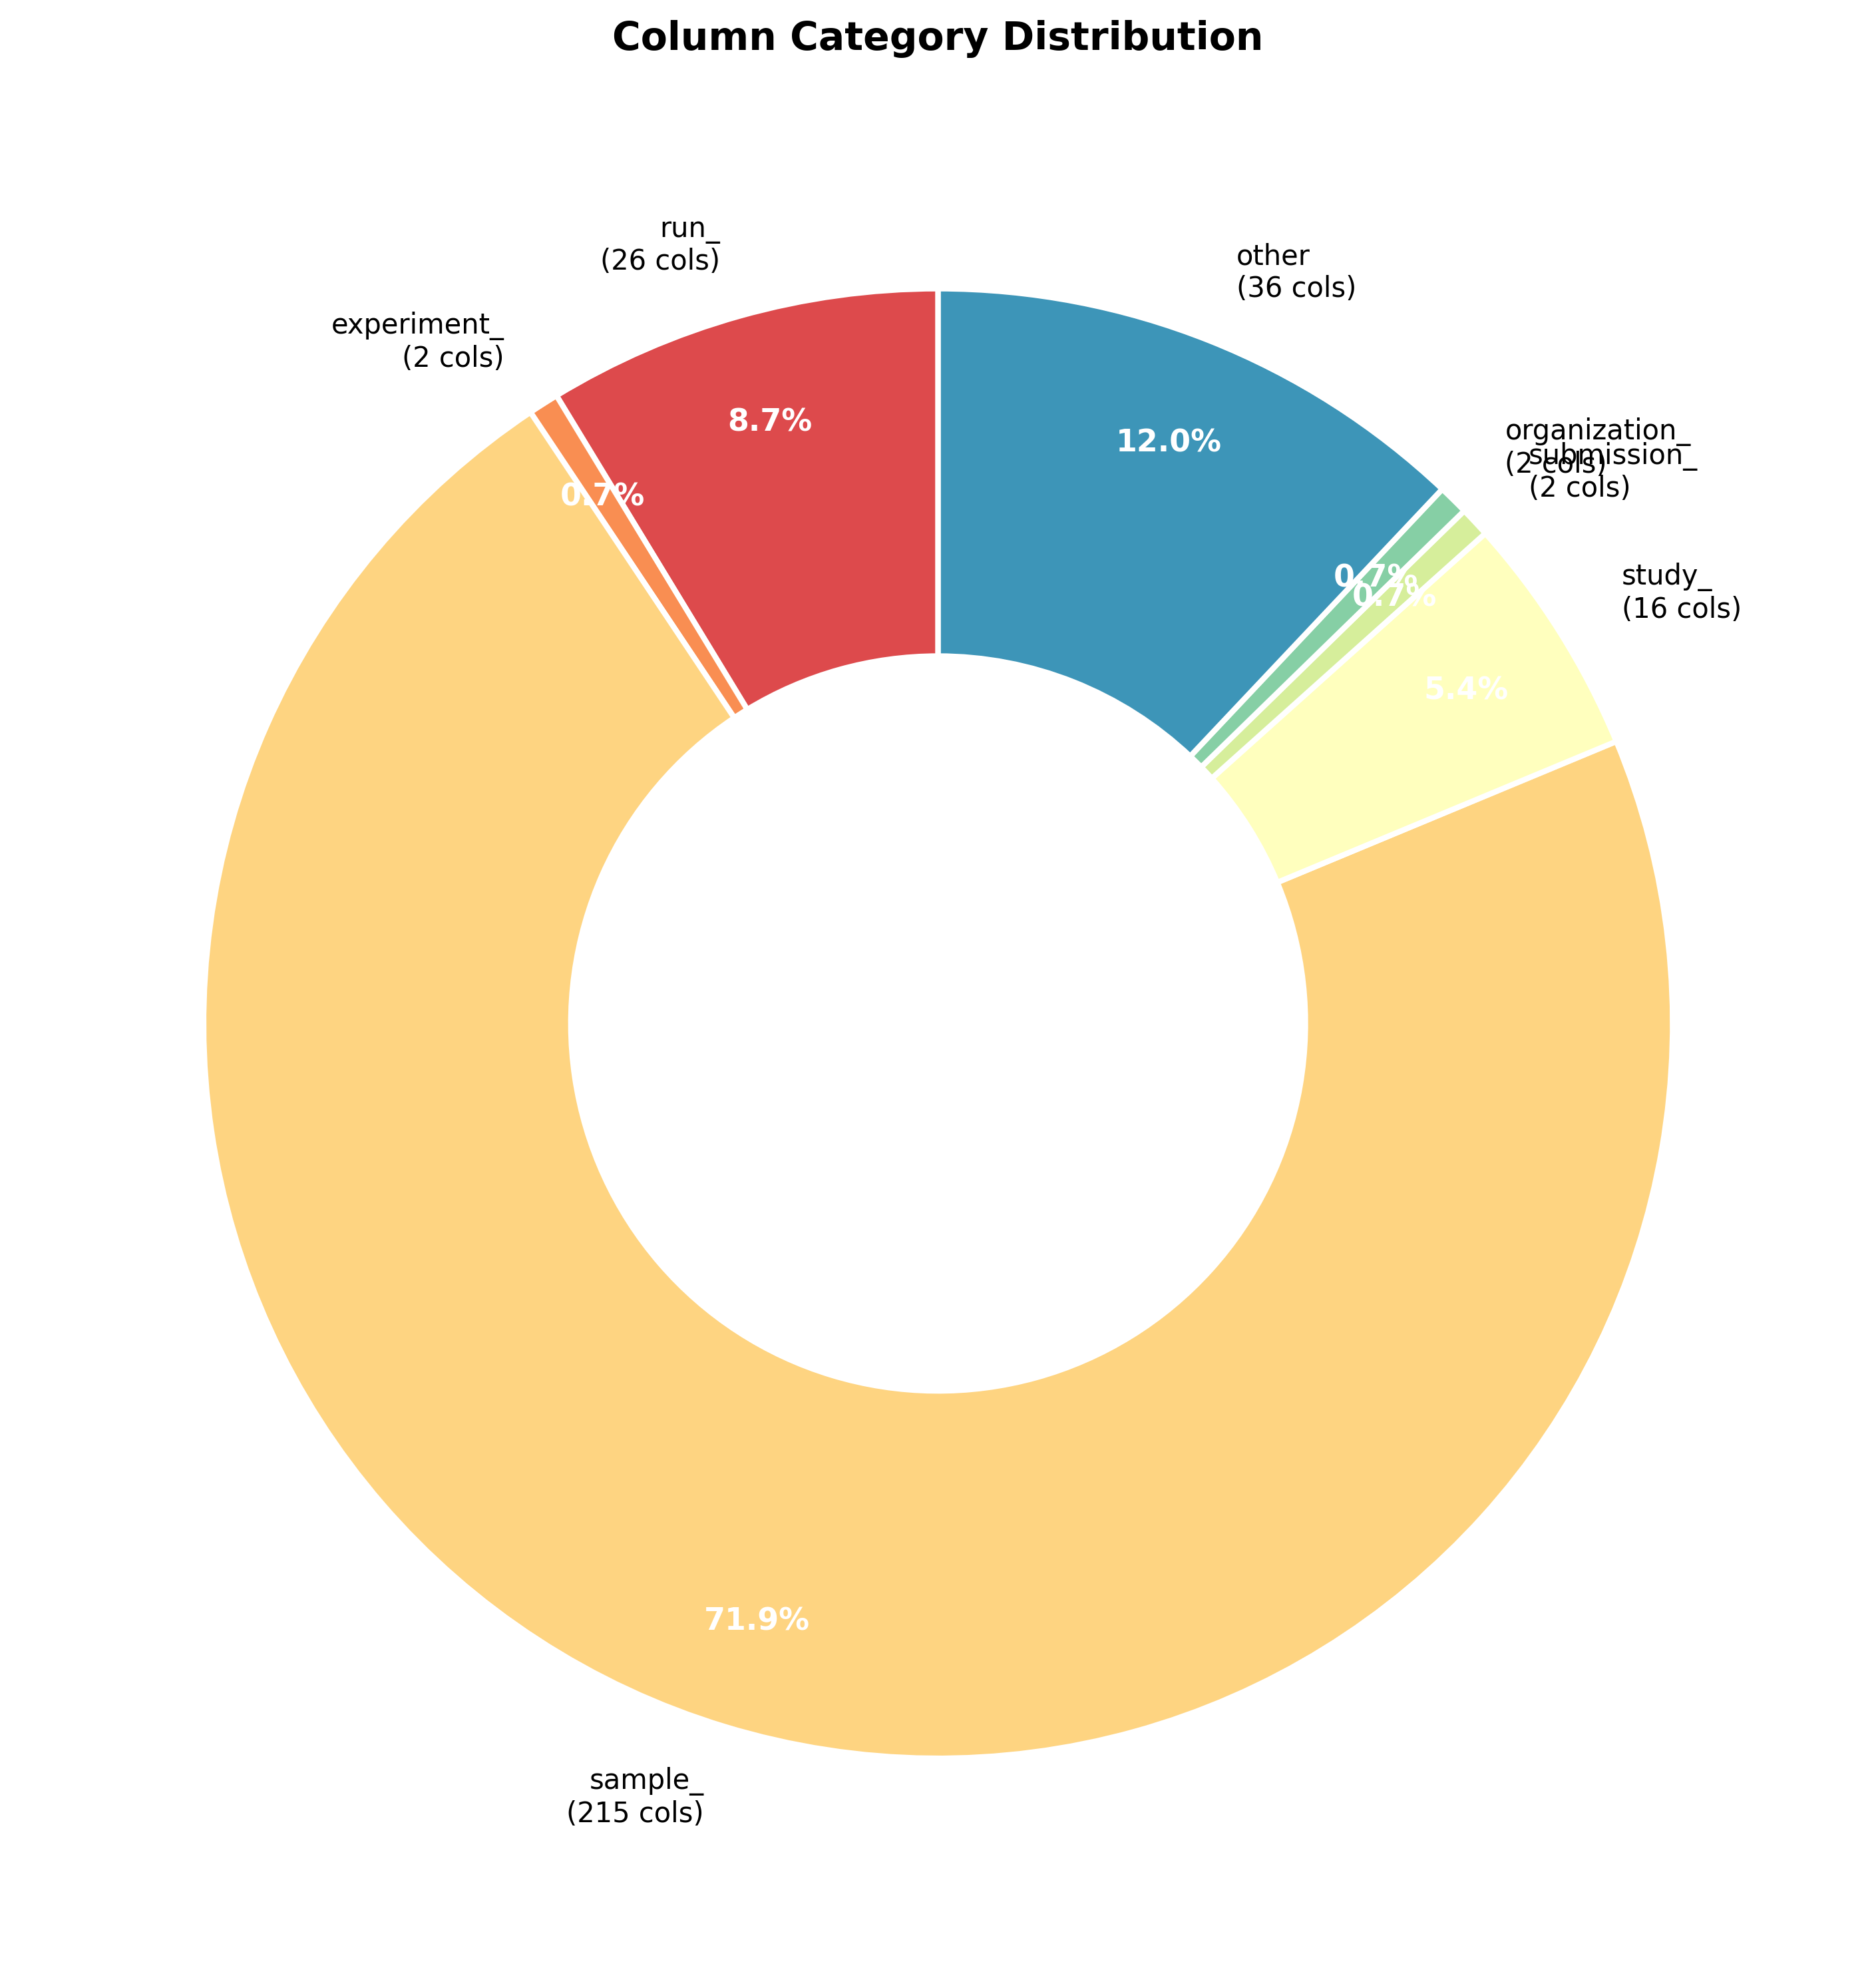
Column Categories

Slide 33
Technical Parameters

Slide 34
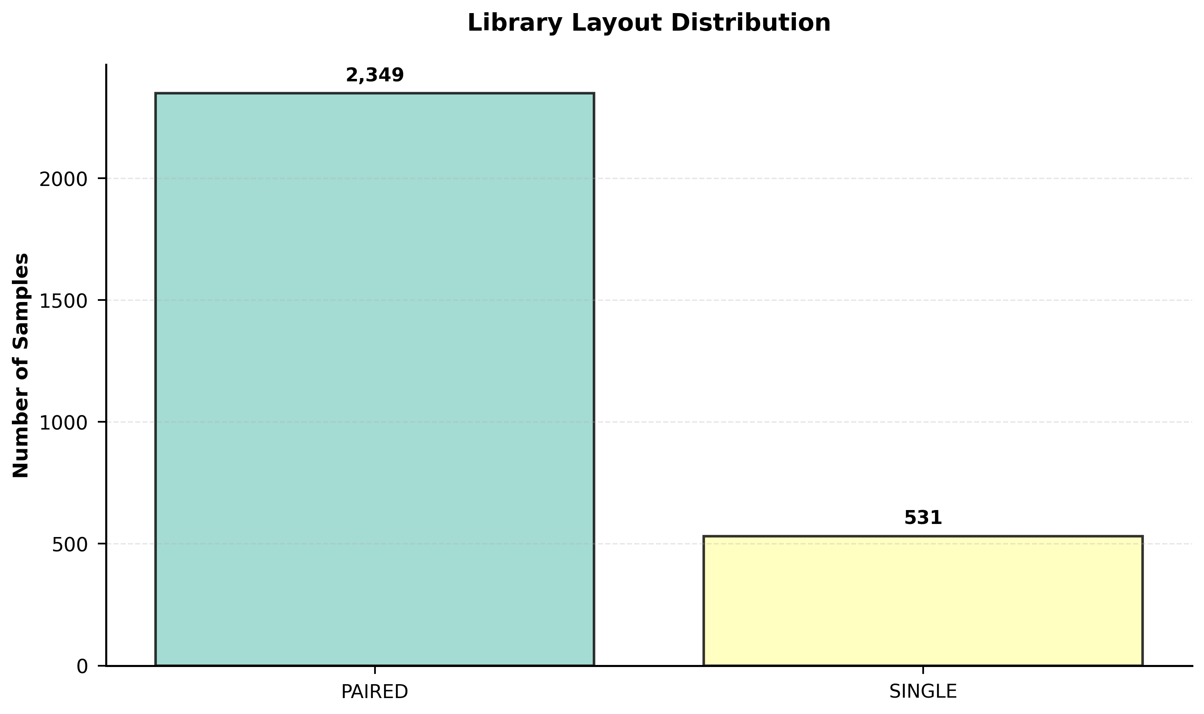
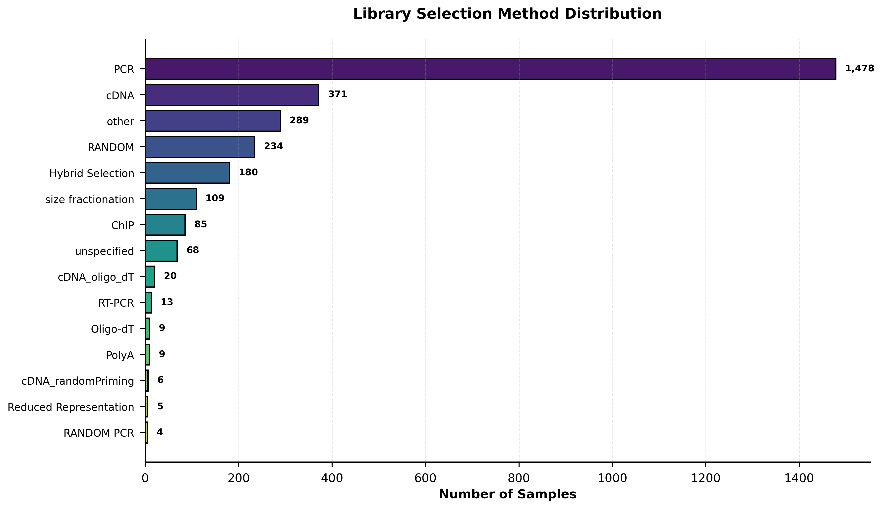
Technical Parameters

Slide 35
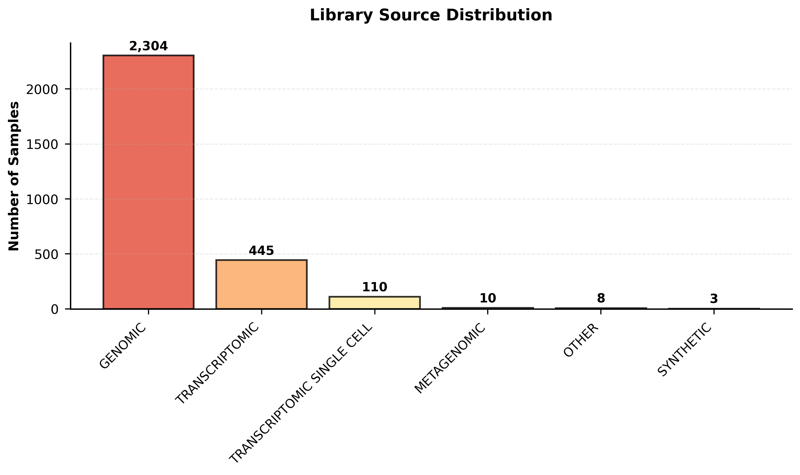
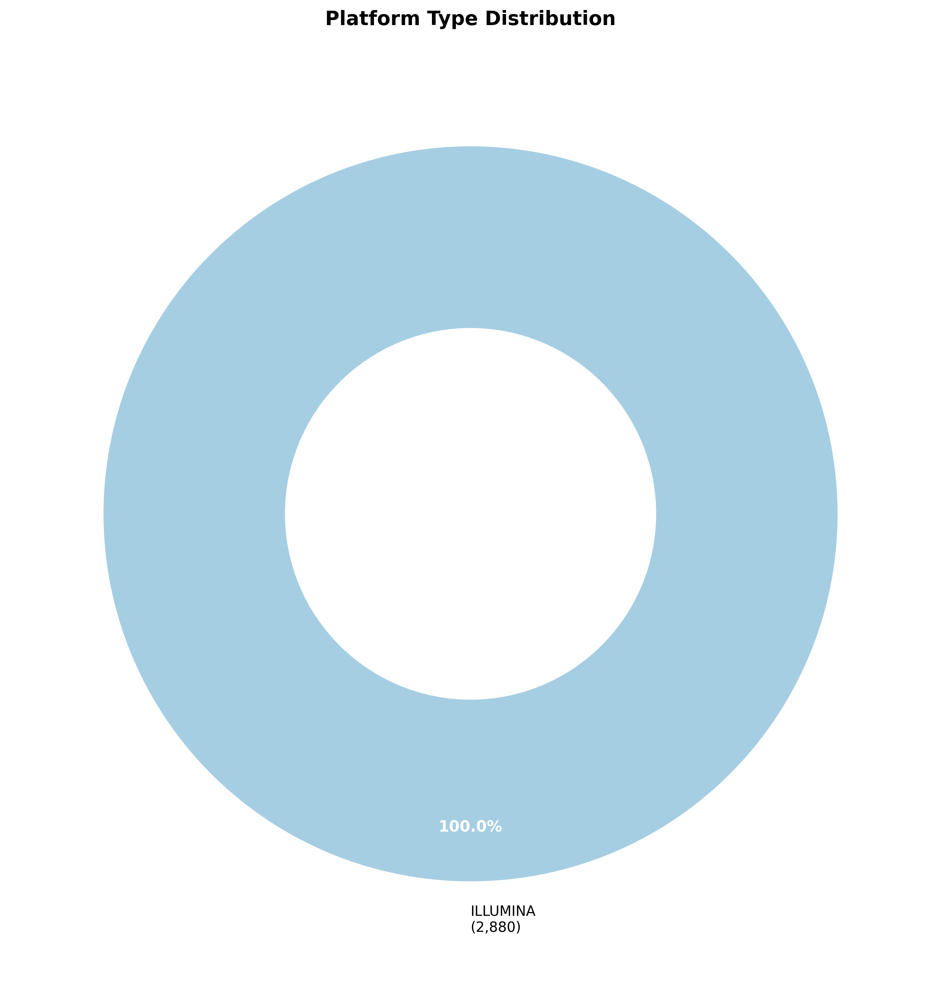
Technical Parameters

Slide 36
Quality Metrics

Slide 37
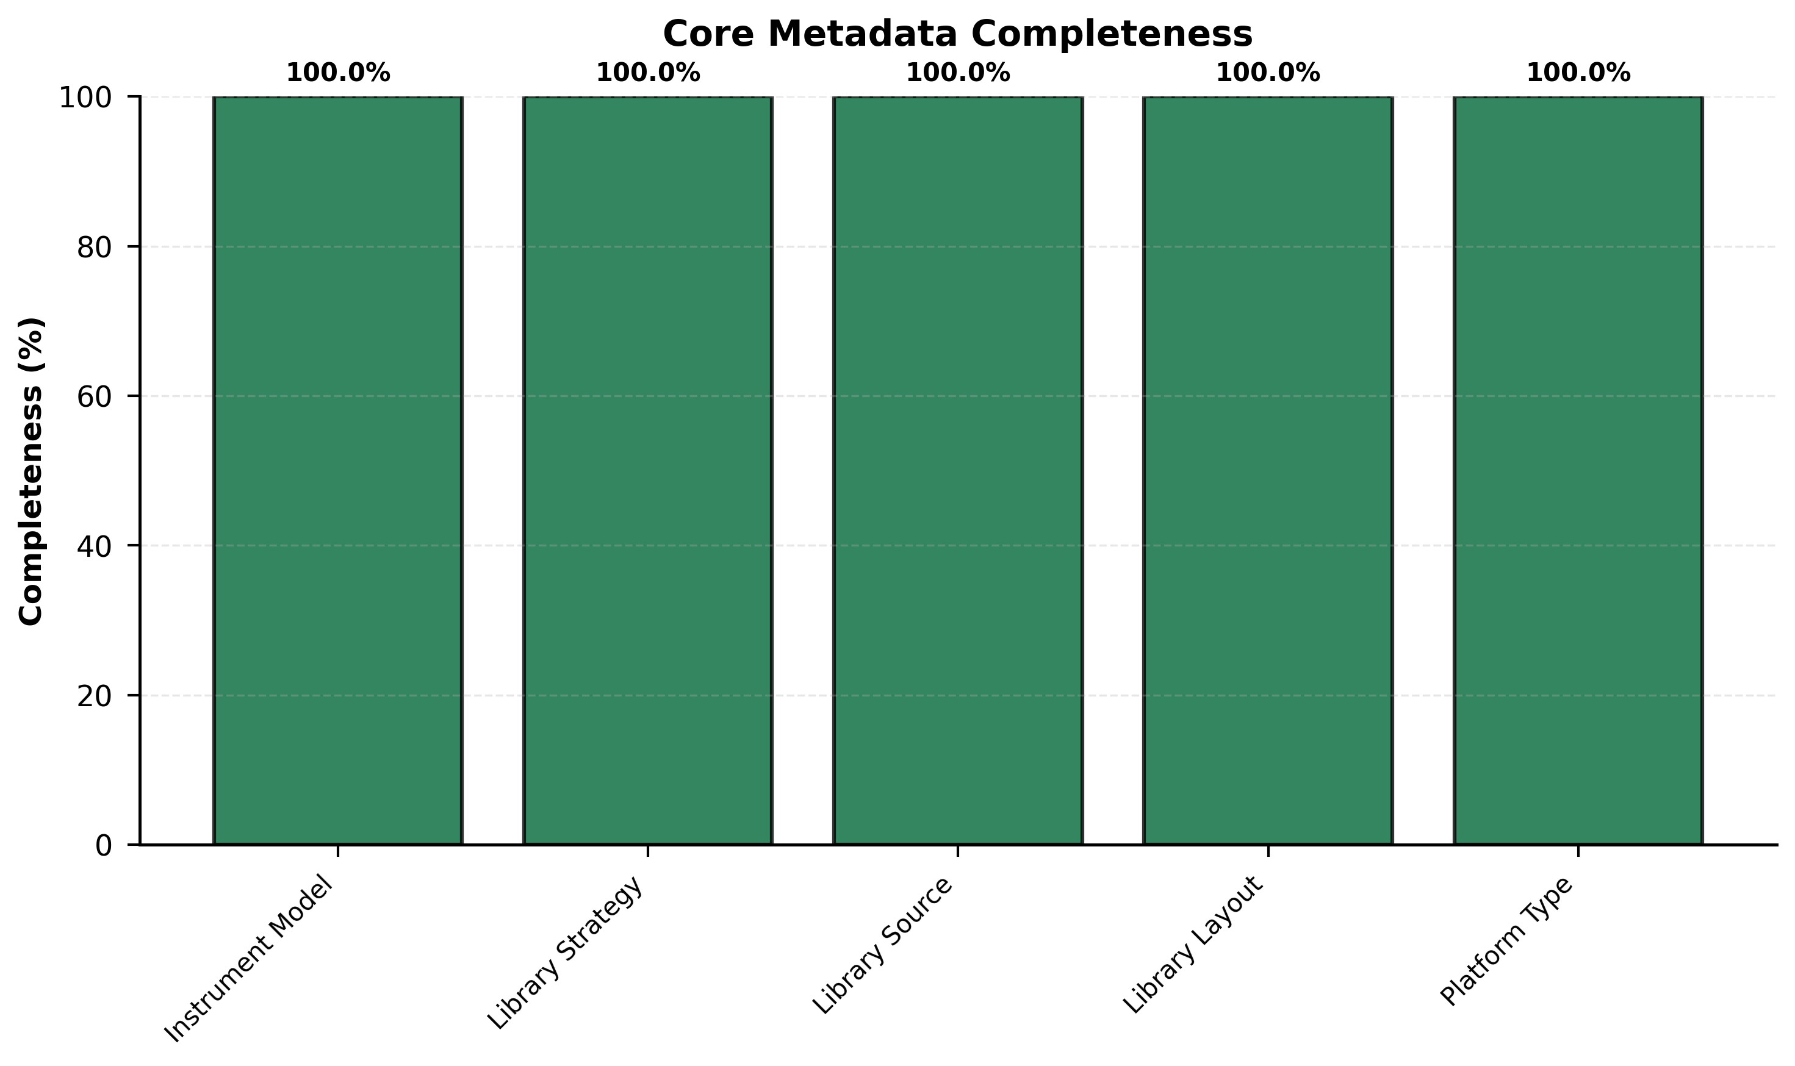
Quality Metrics

Slide 38
Statistical Summary

Slide 39
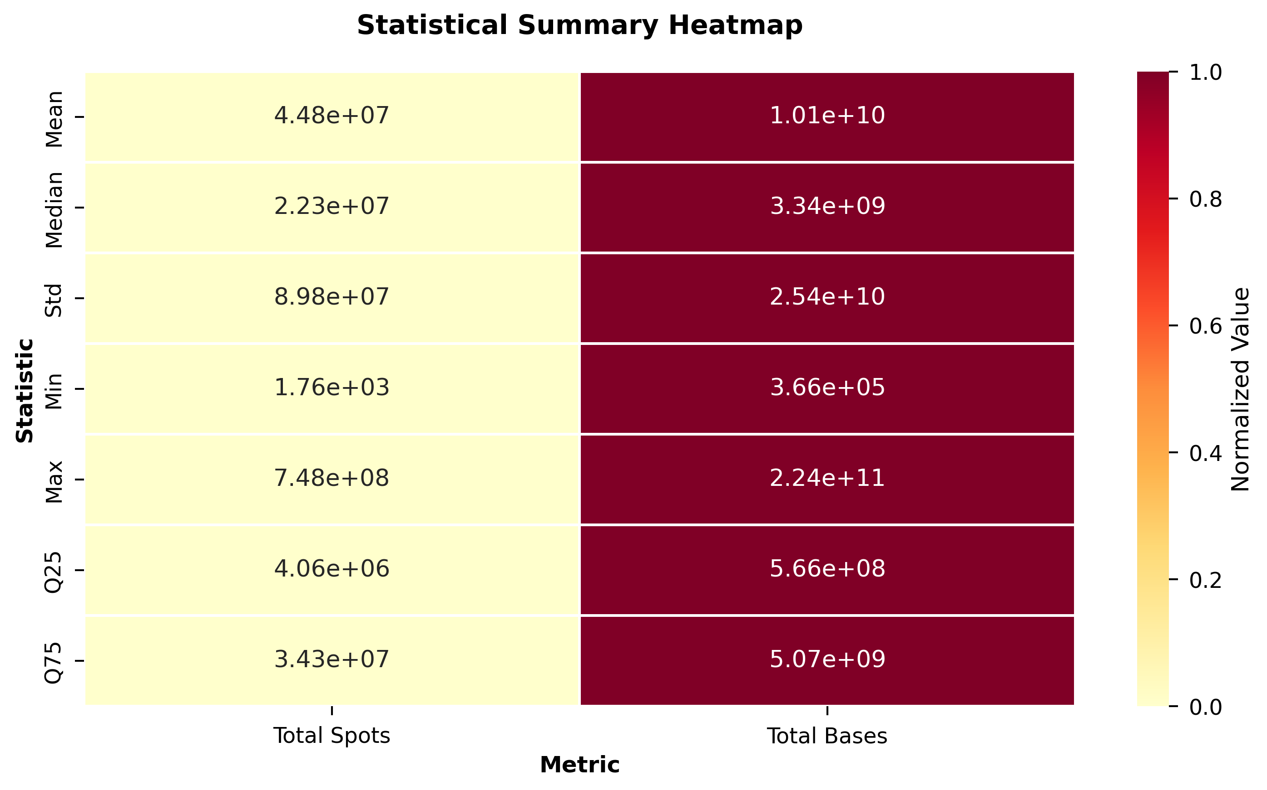
Statistical Summary

Slide 40
Dataset Summary

Slide 41
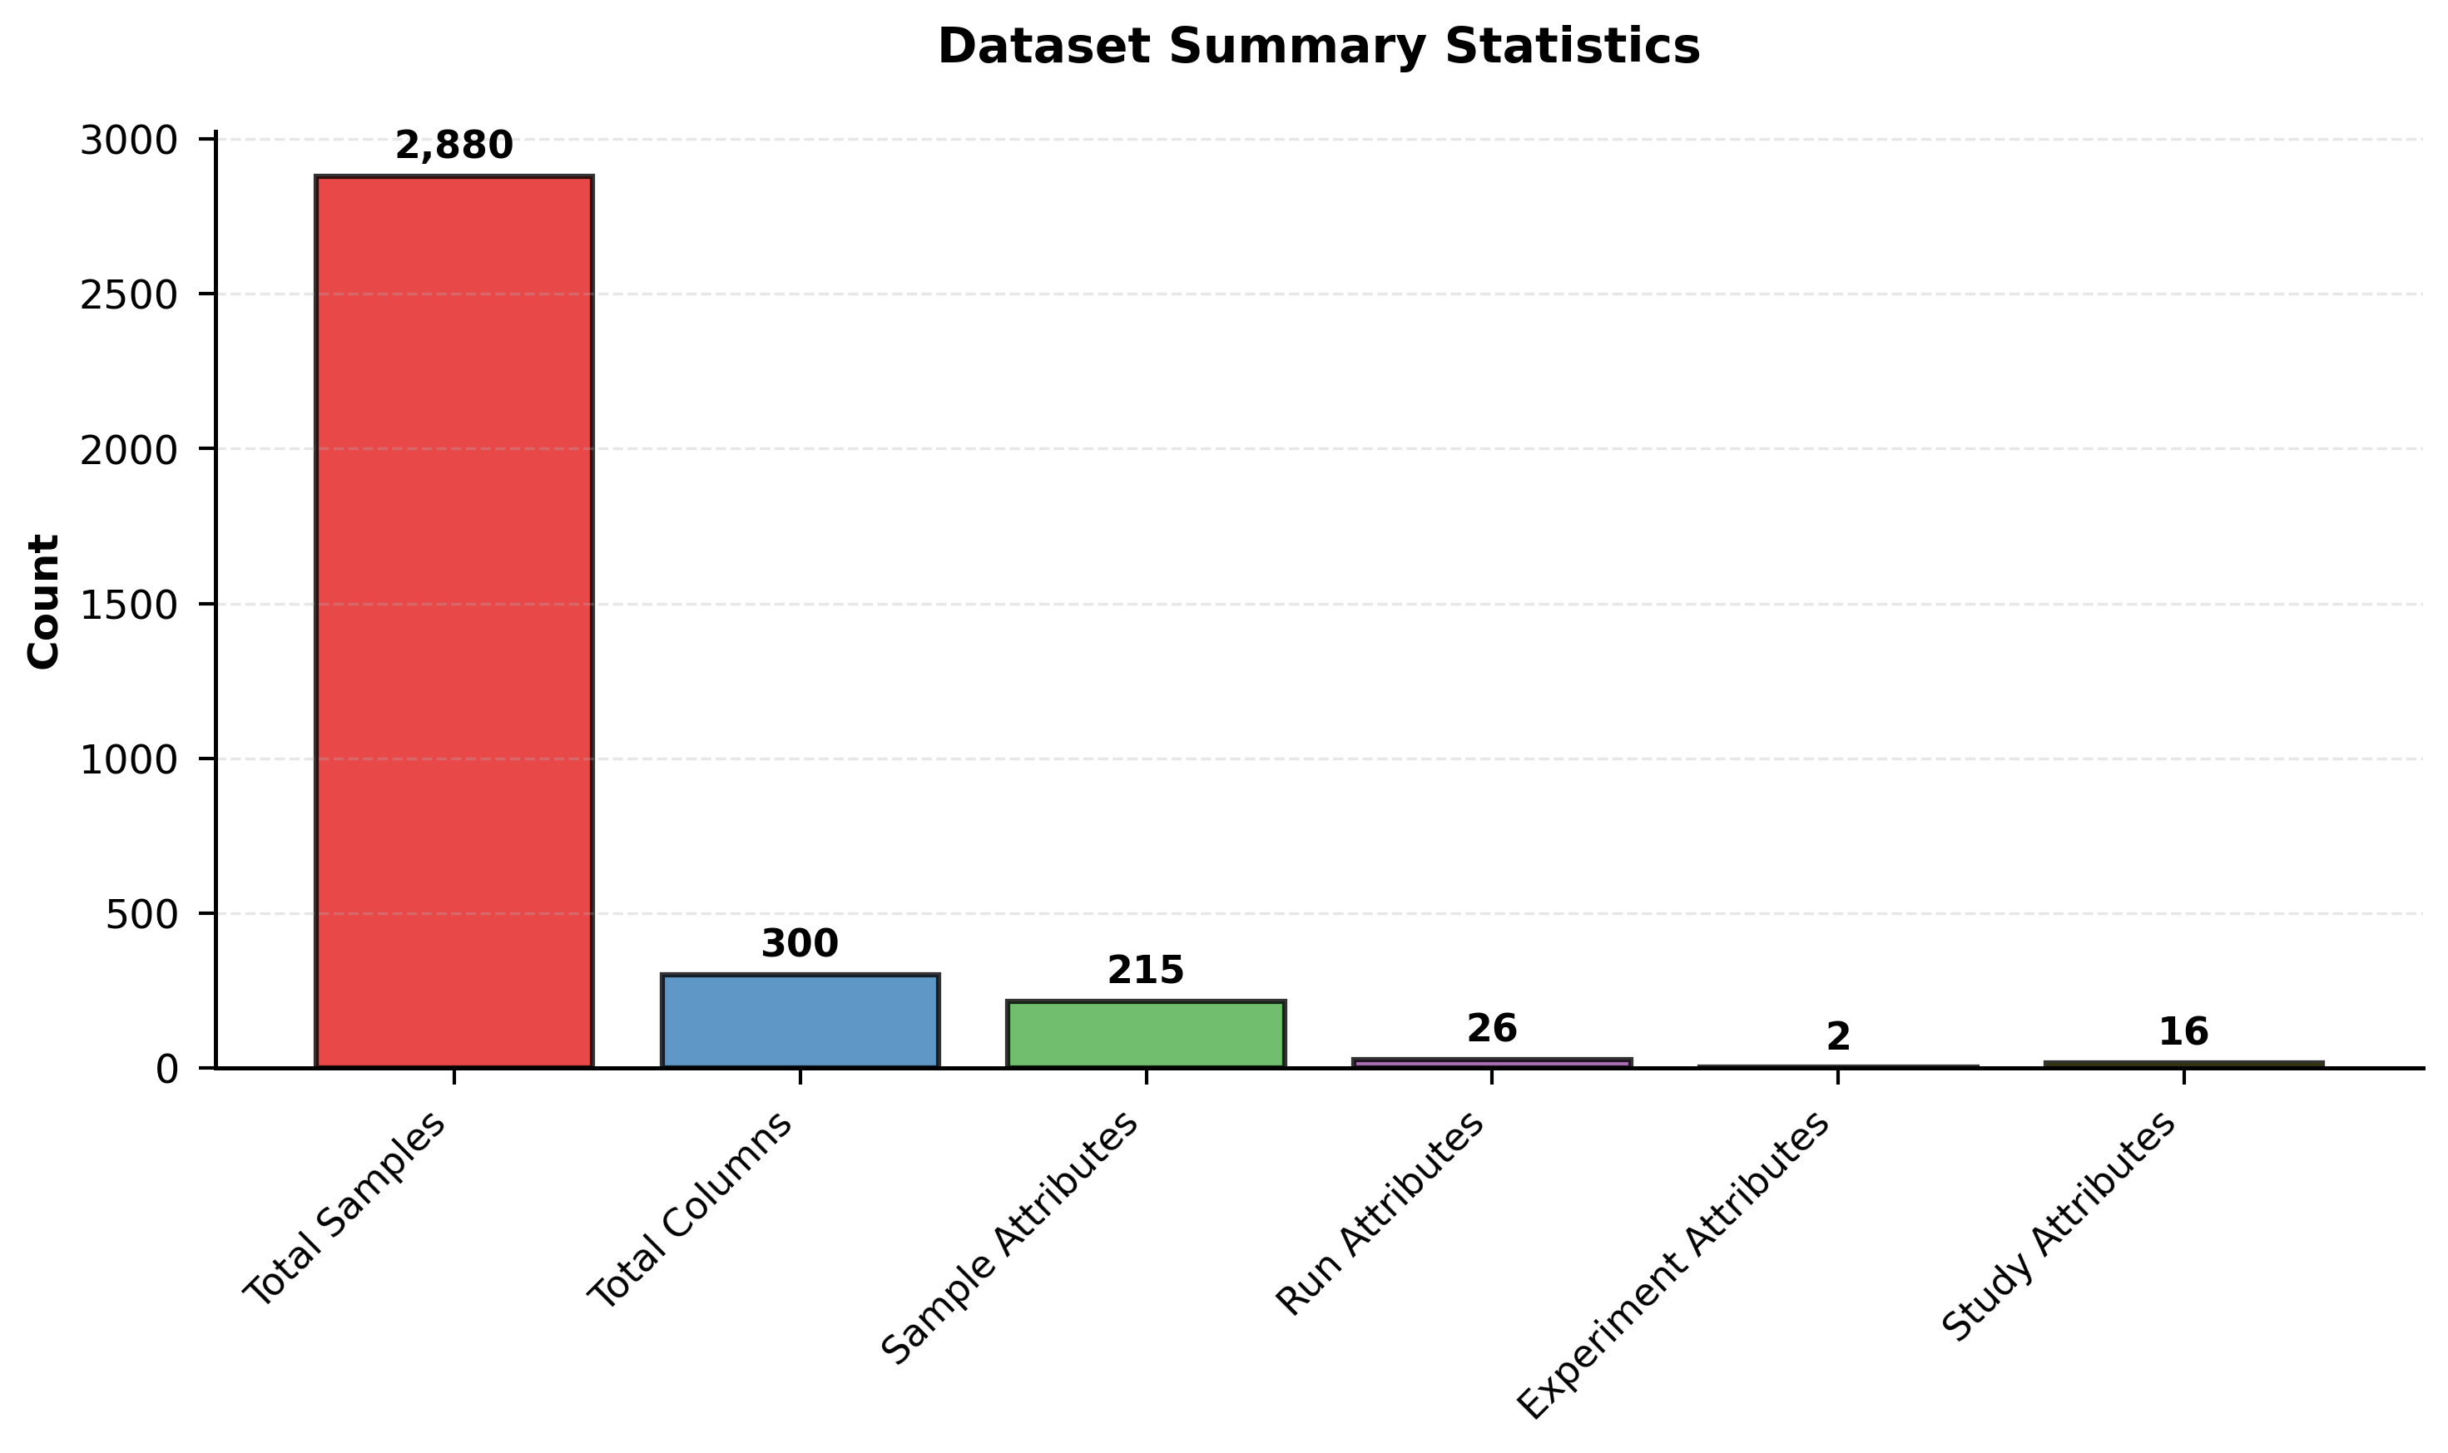
Dataset Summary

Slide 42
Sample-Level Analysis (Patient Deduplication)

Slide 43
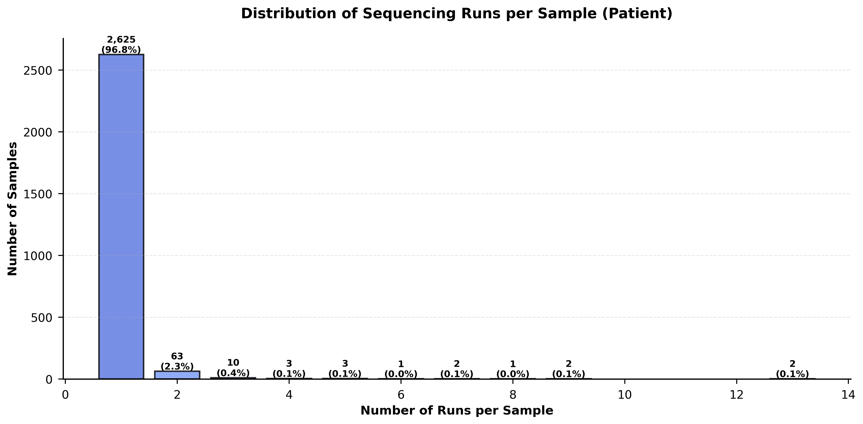
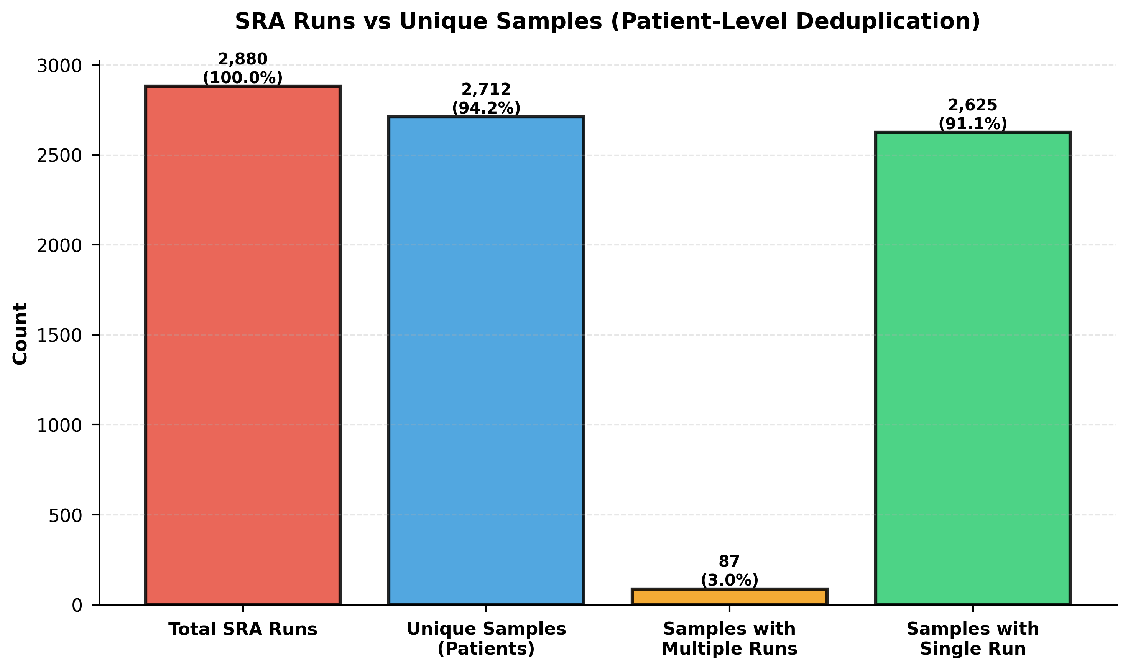
Sample-Level Analysis (Patient Deduplication)

Slide 44
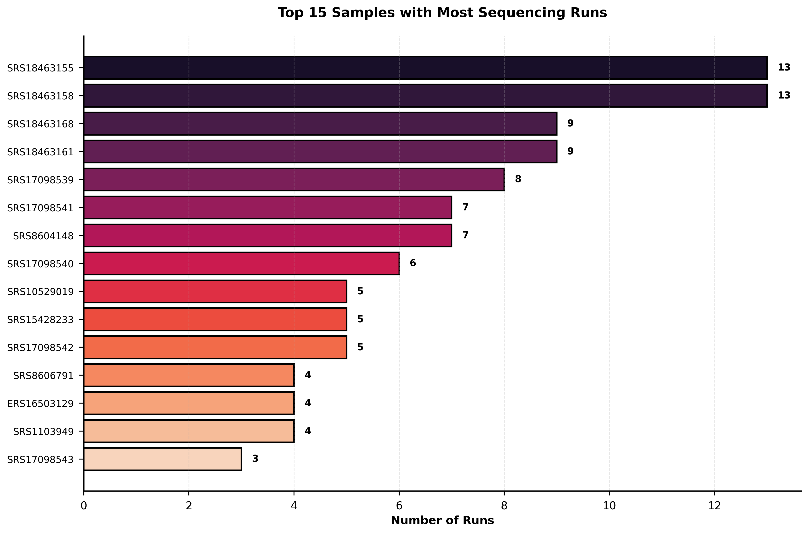
Sample-Level Analysis (Patient Deduplication)

Slide 45
Comprehensive Phenotype Analysis

Slide 46
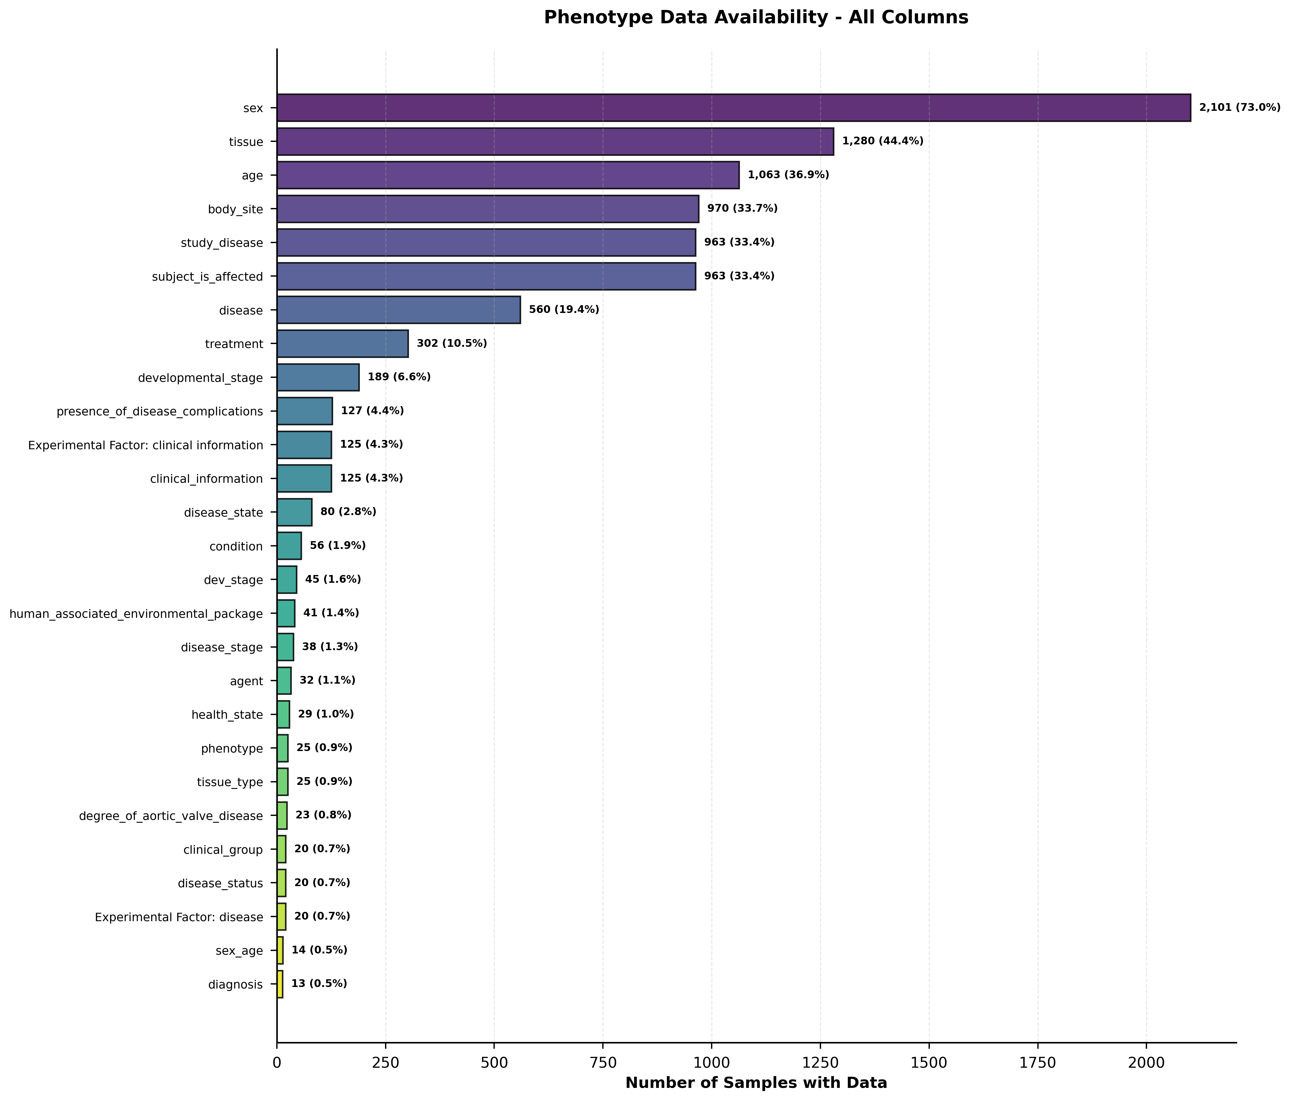
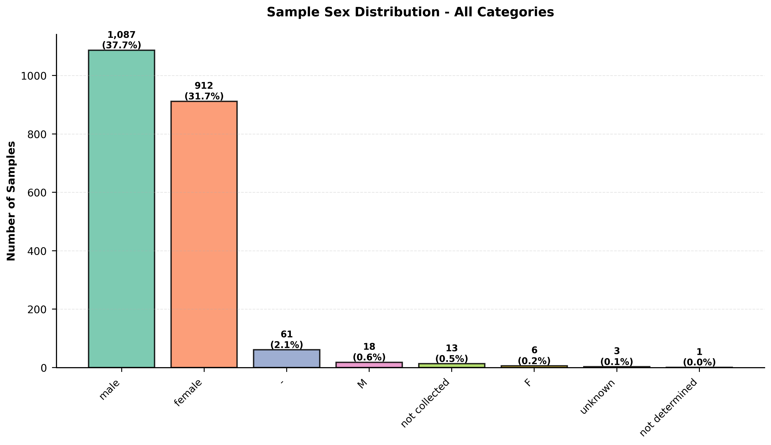
Comprehensive Phenotype Analysis

Slide 47
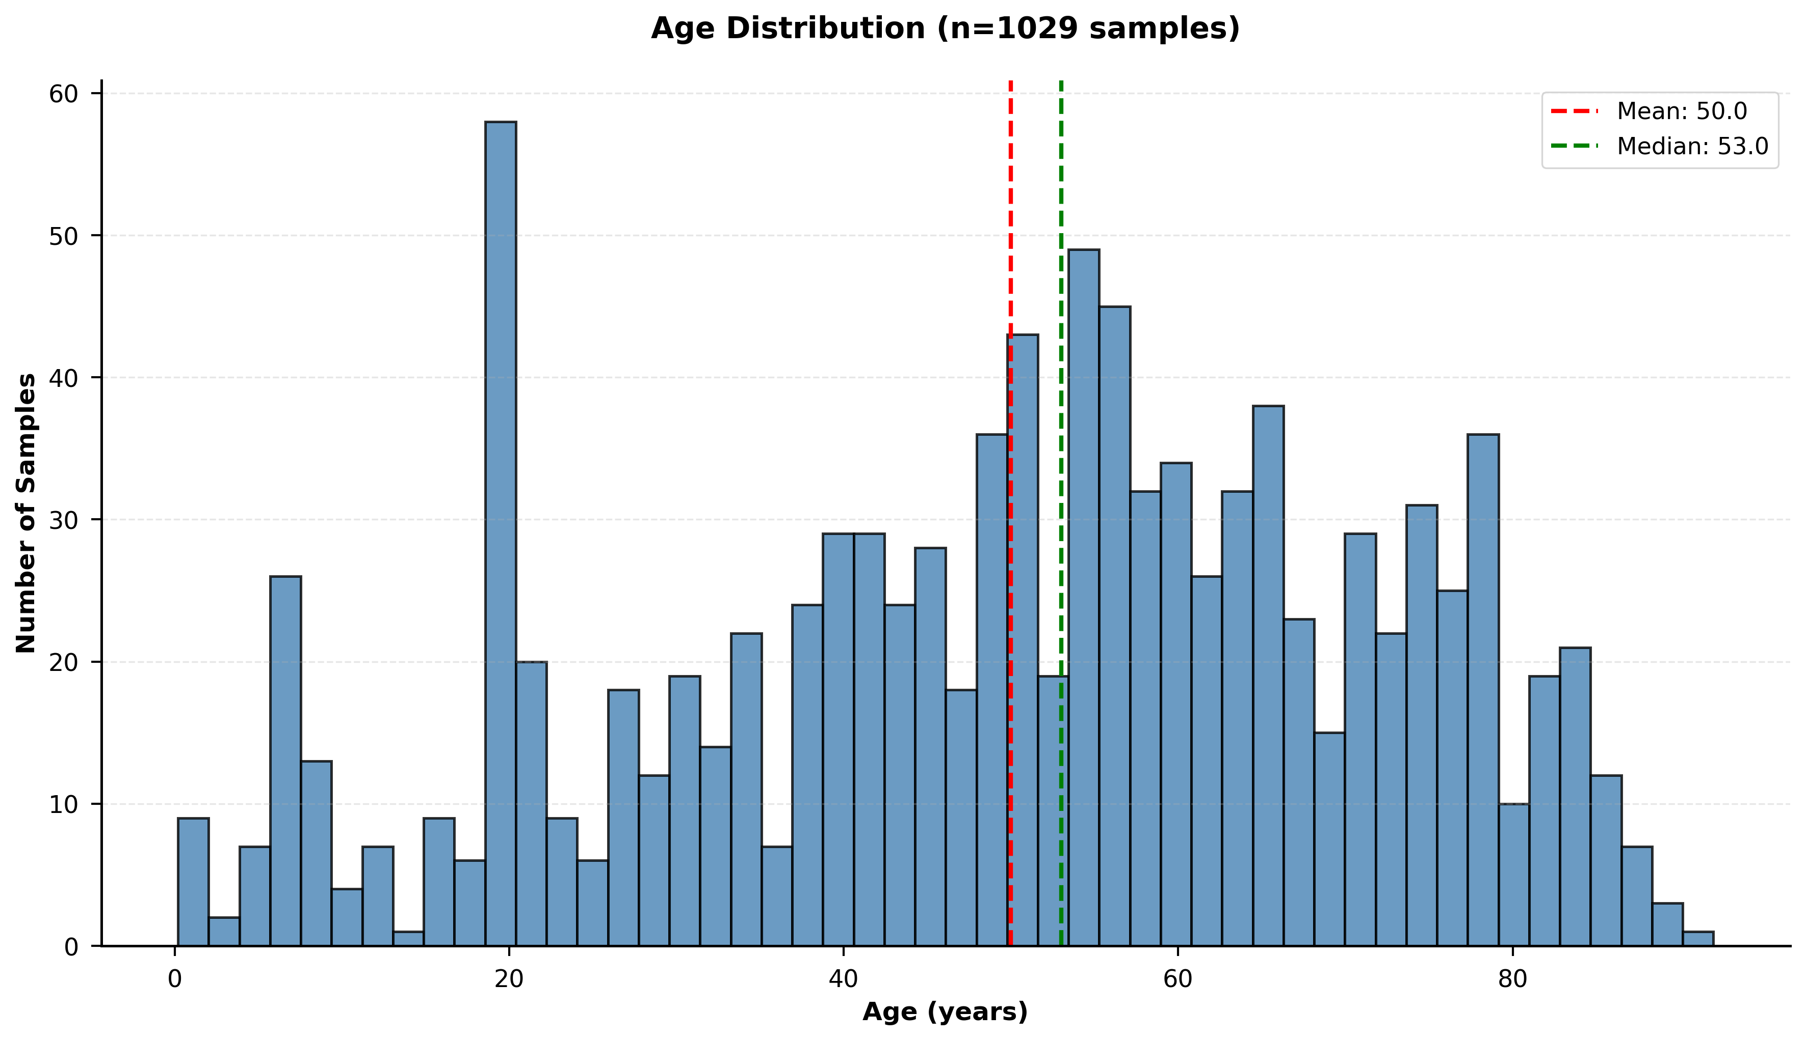
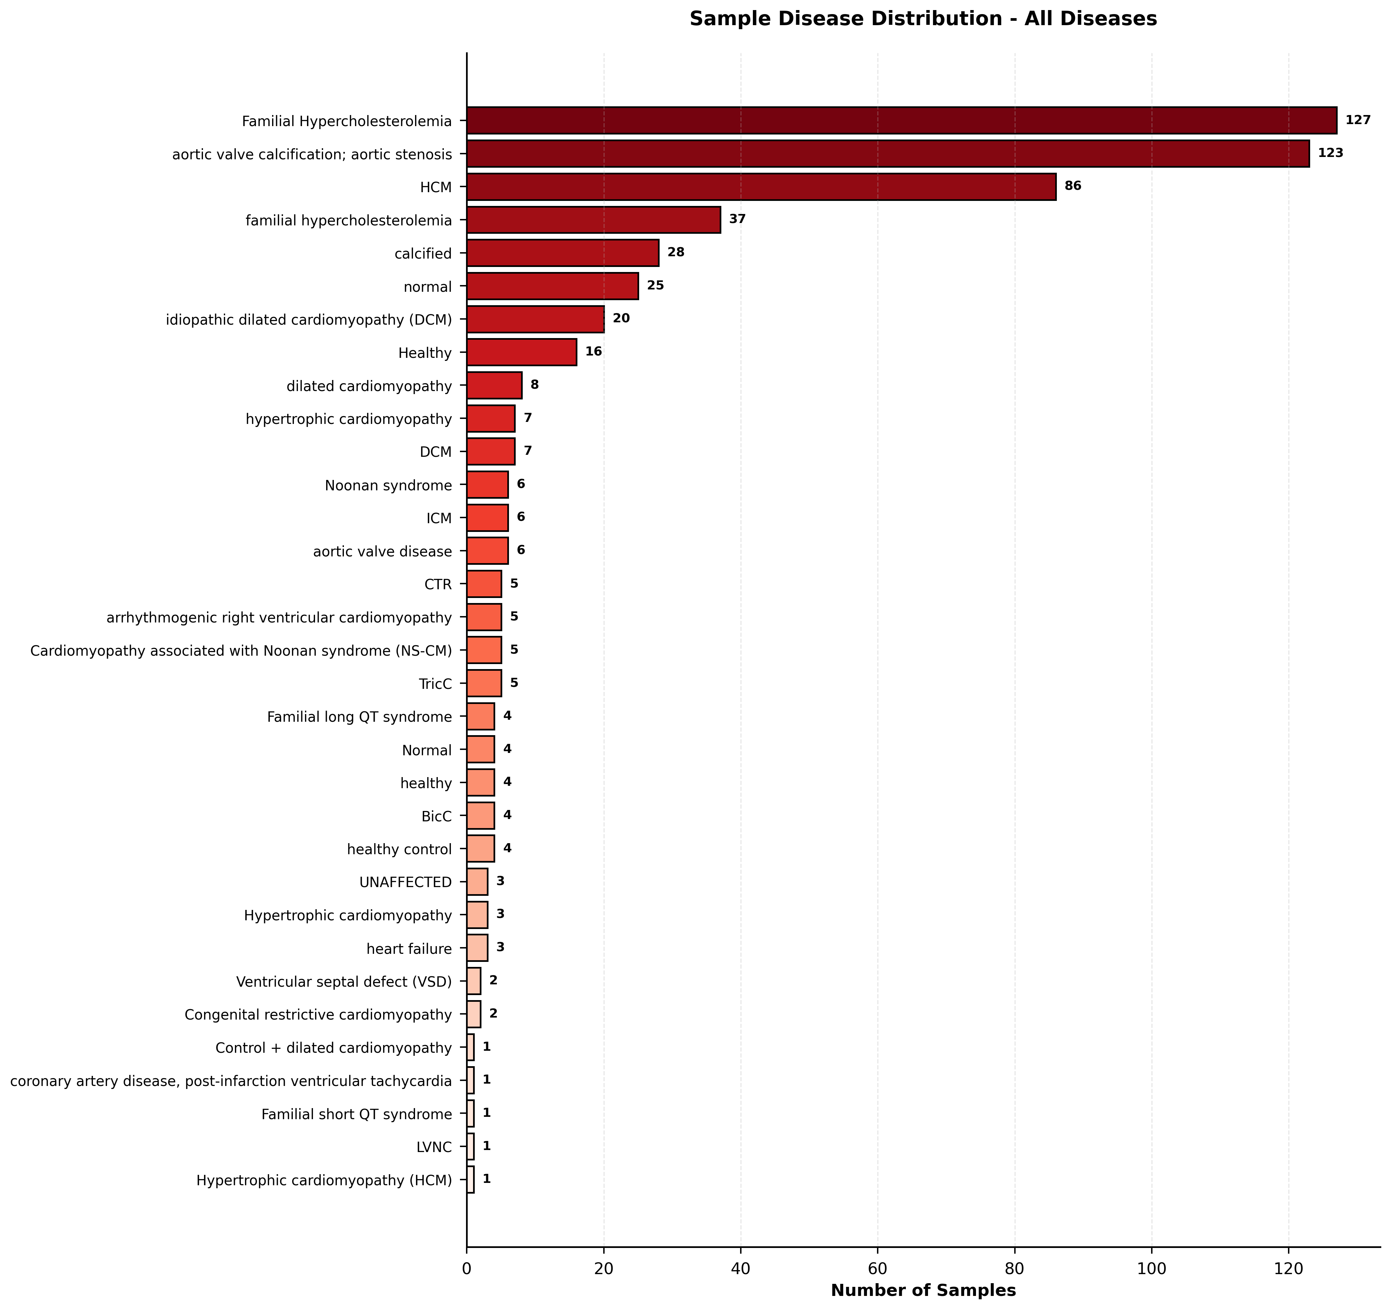
Comprehensive Phenotype Analysis

Slide 48
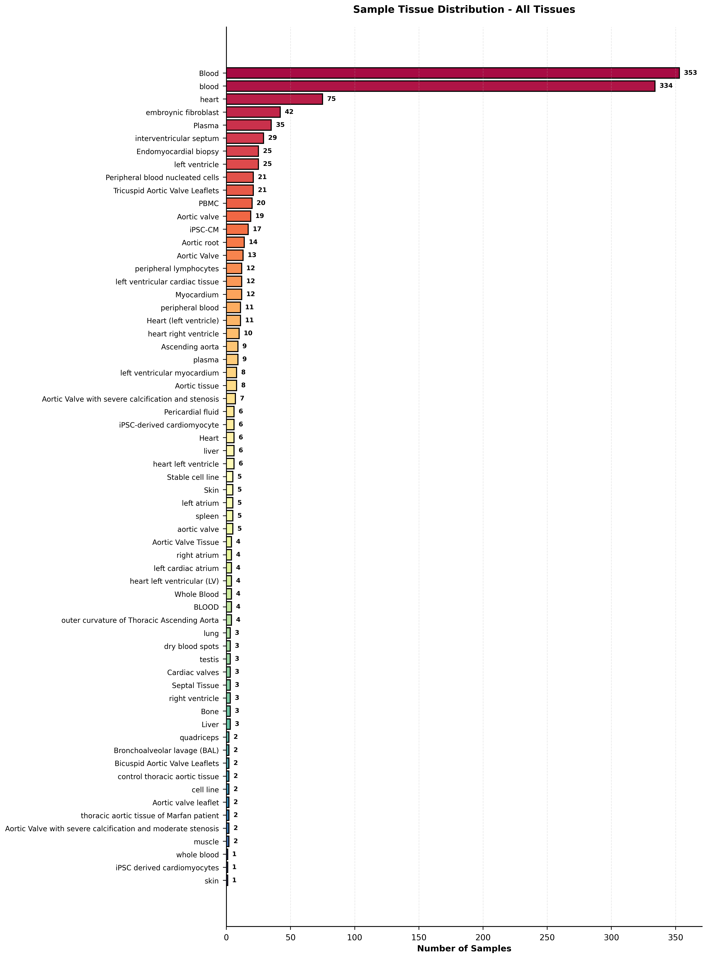
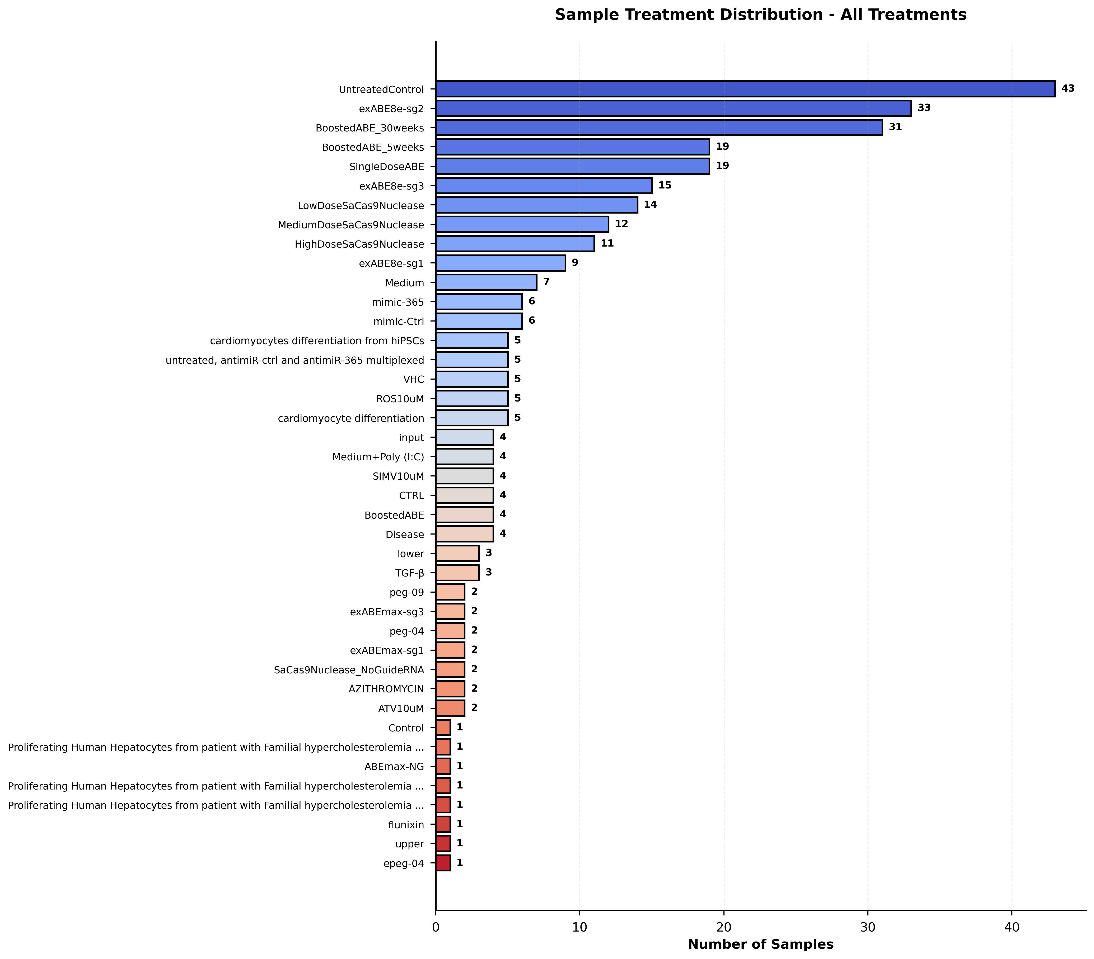
Comprehensive Phenotype Analysis

Slide 49
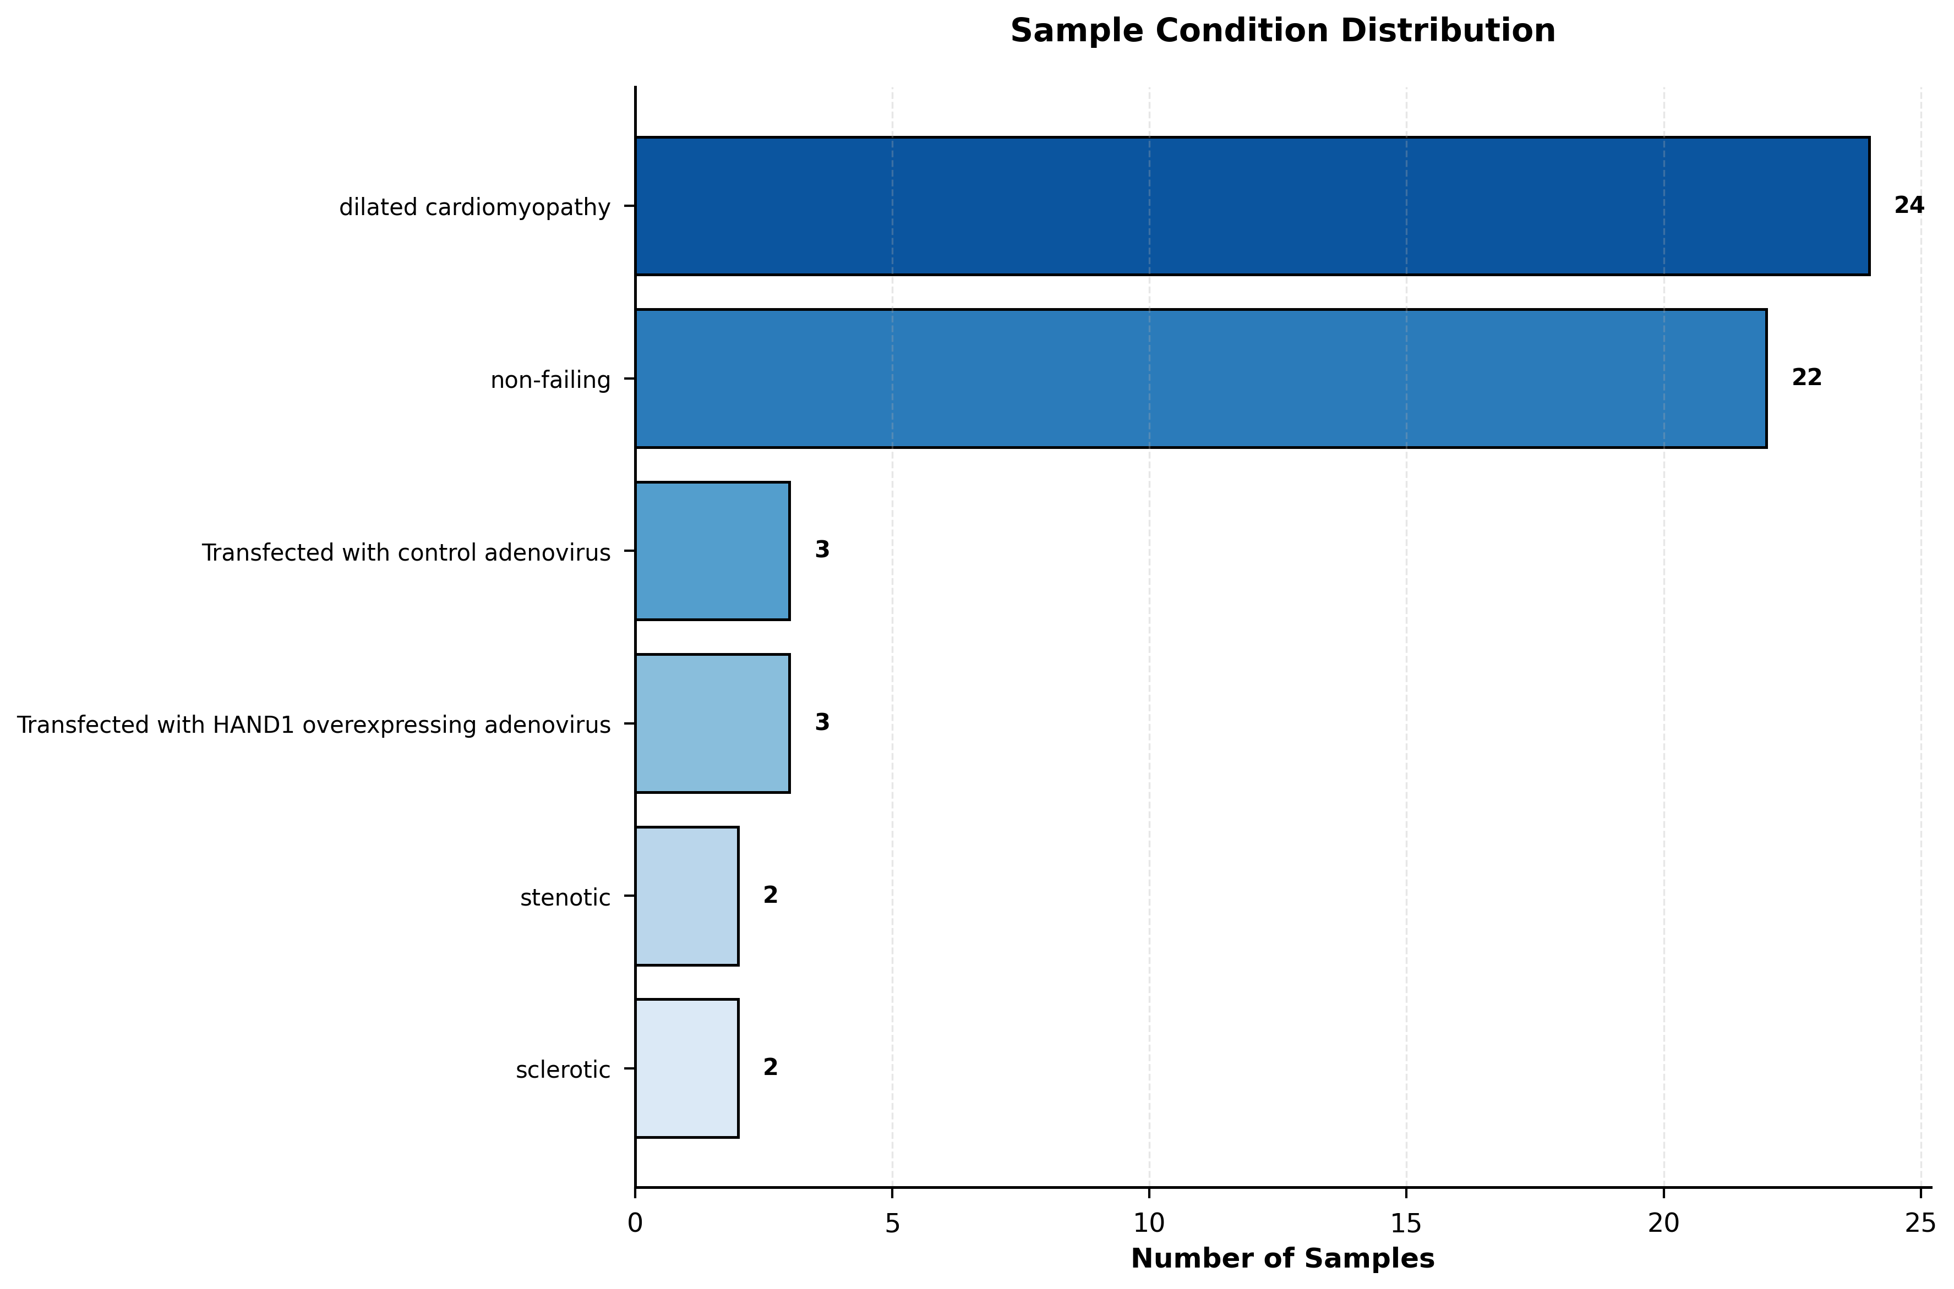
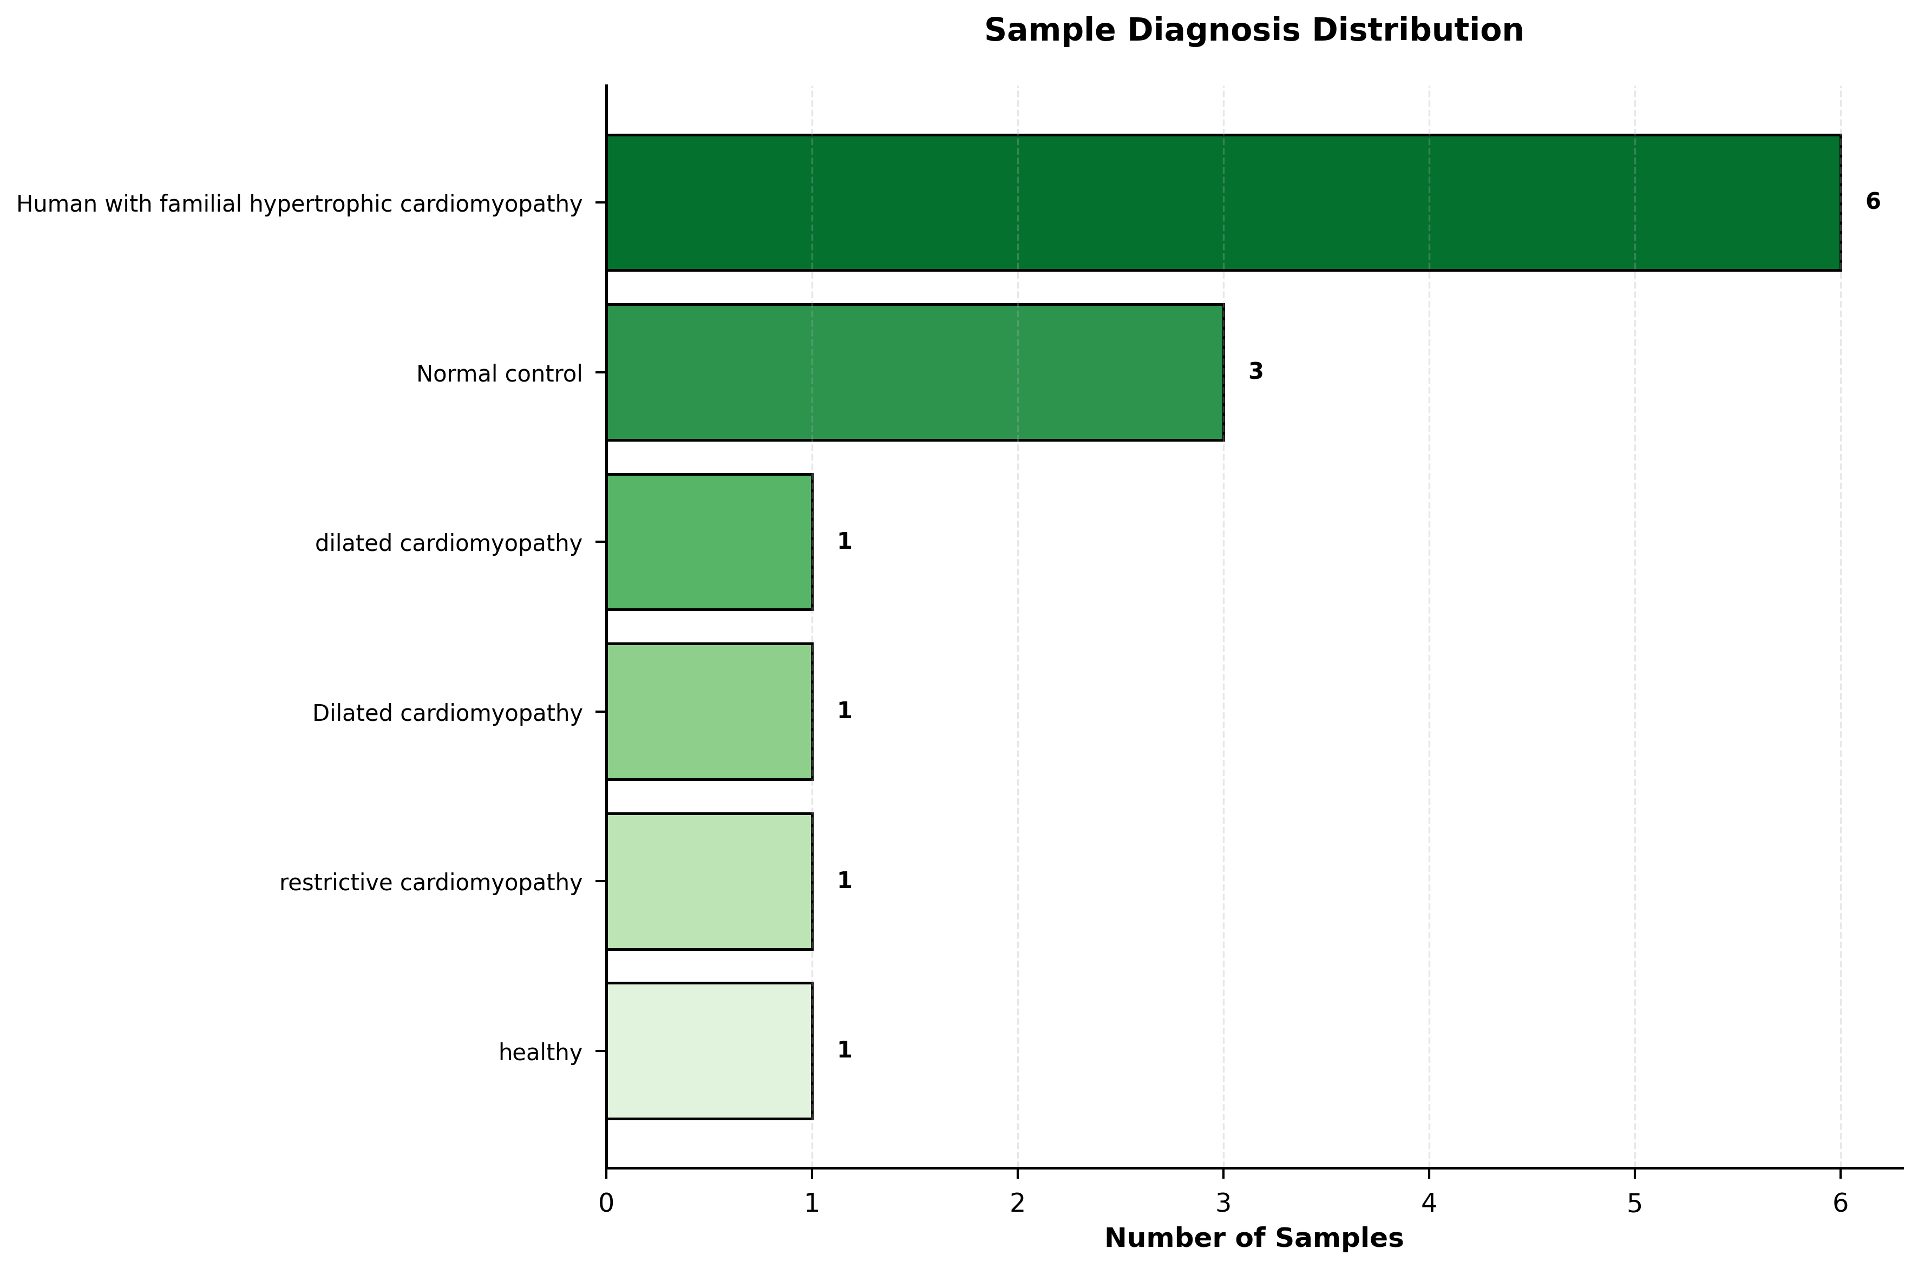
Comprehensive Phenotype Analysis

Slide 50
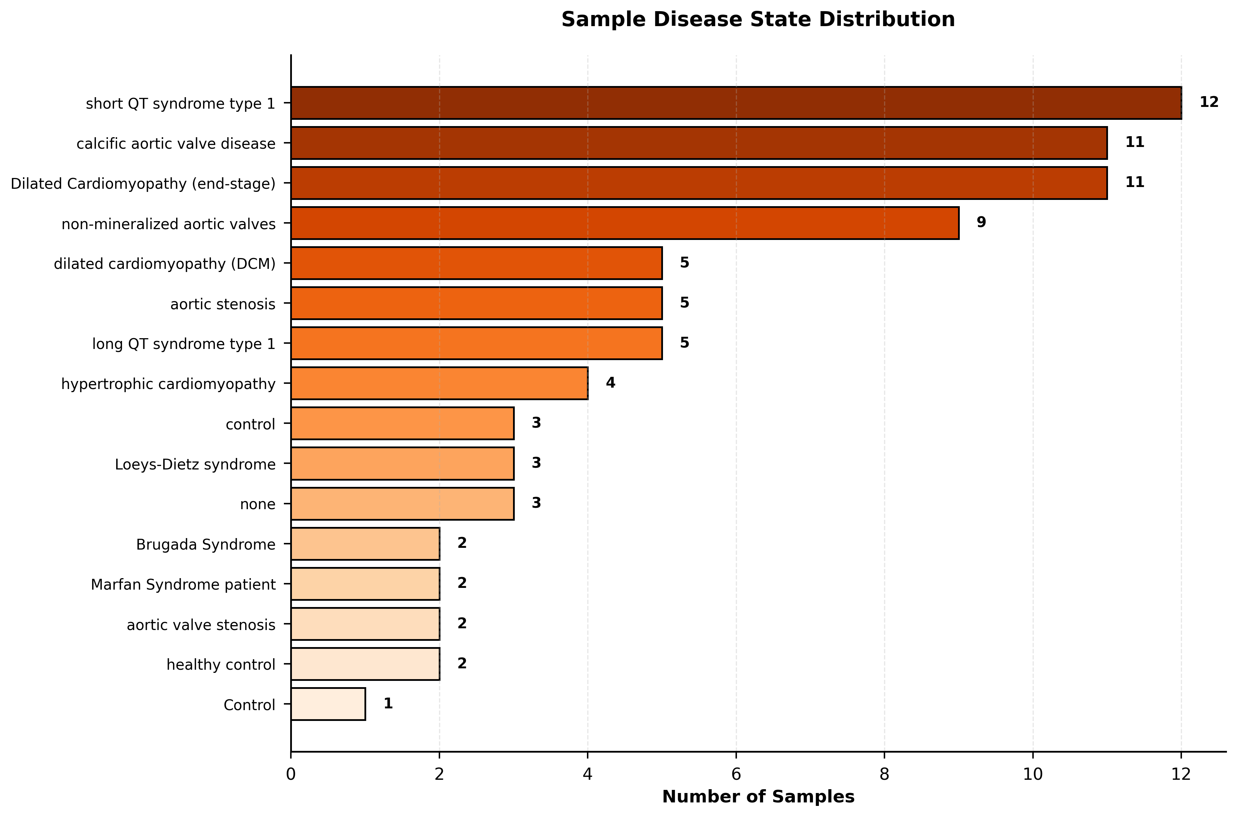
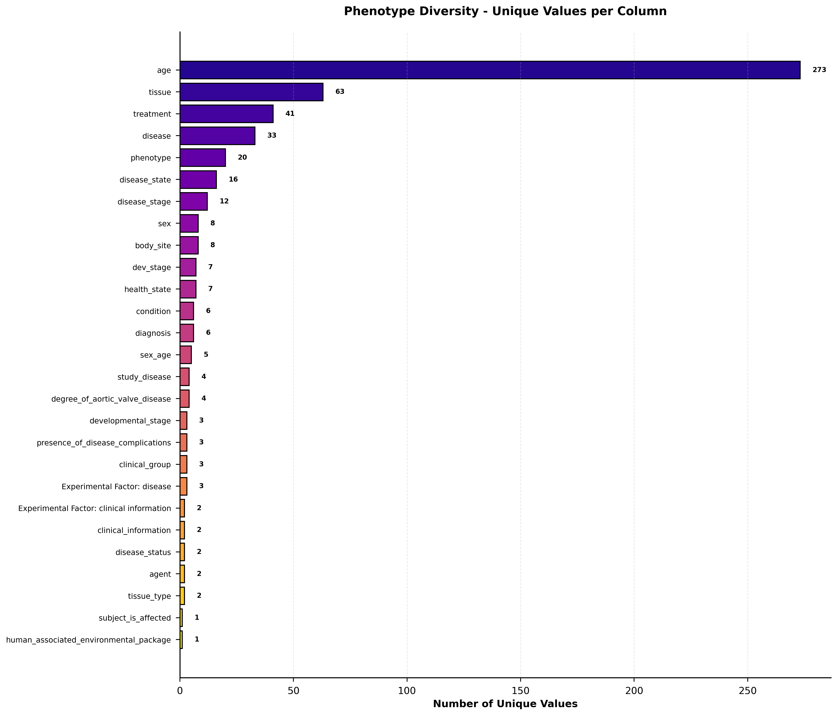
Comprehensive Phenotype Analysis

